Slide 1
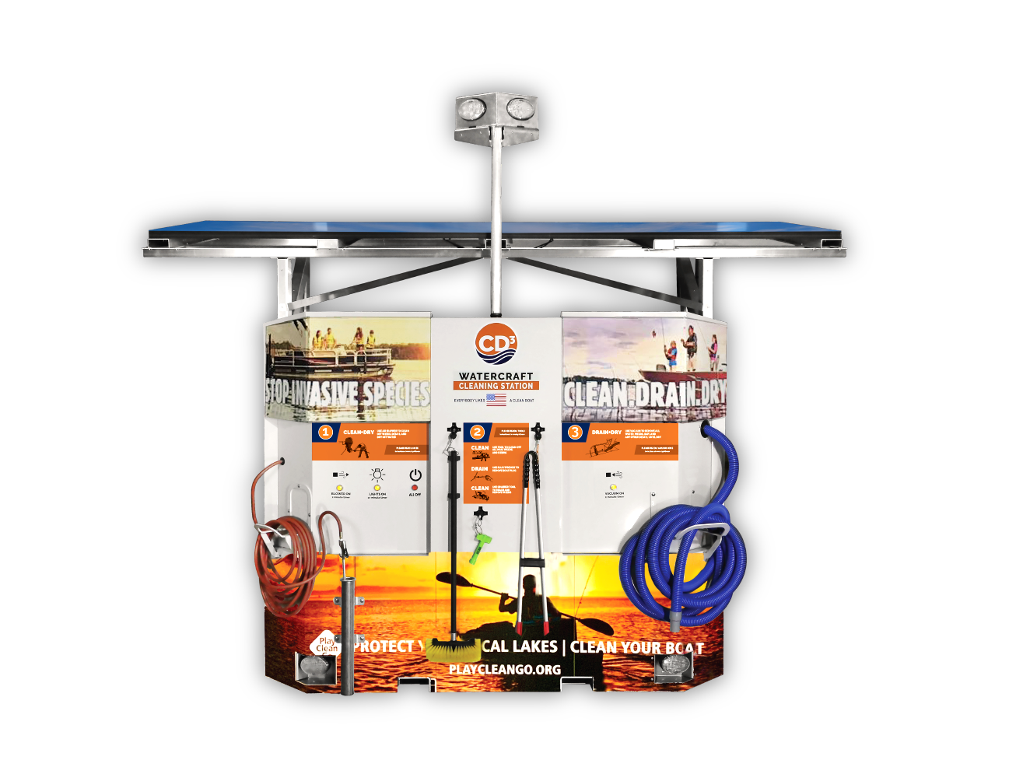
Free-to-Use Waterless Infrastructure
TOP/BOTTOM LED LIGHTS
OFF-GRID
SOLAR POWER
INTERNET
CONNECTED
EDUCATIONAL
KIOSK AND DECALS
TETHERED
HAND TOOLS
WET/DRY
VACUUM
AIR BLOWER

Slide 2
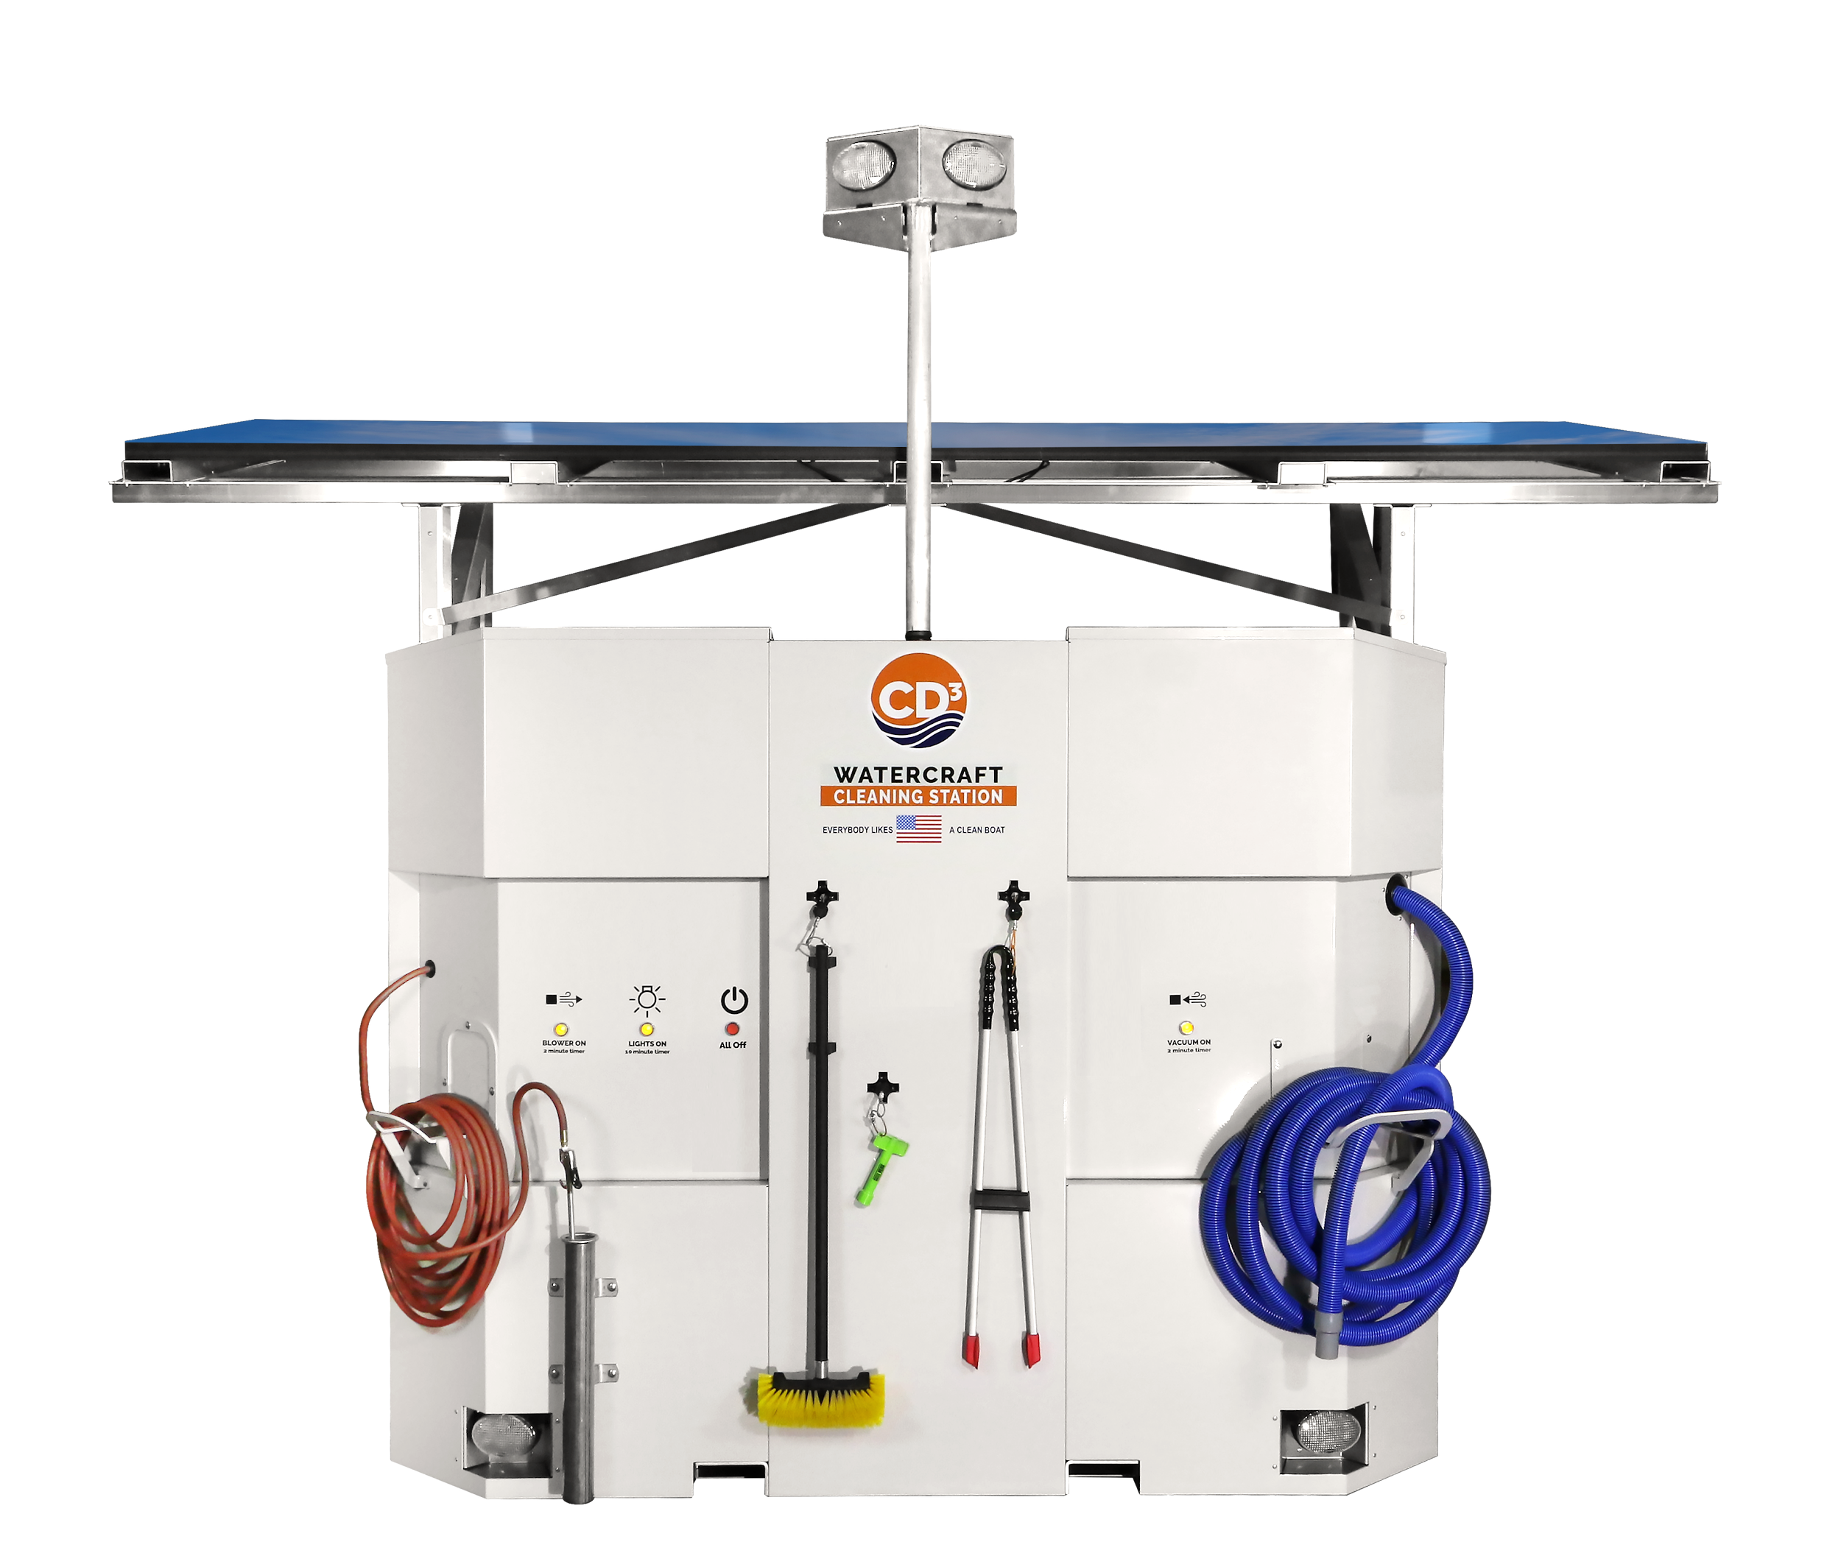
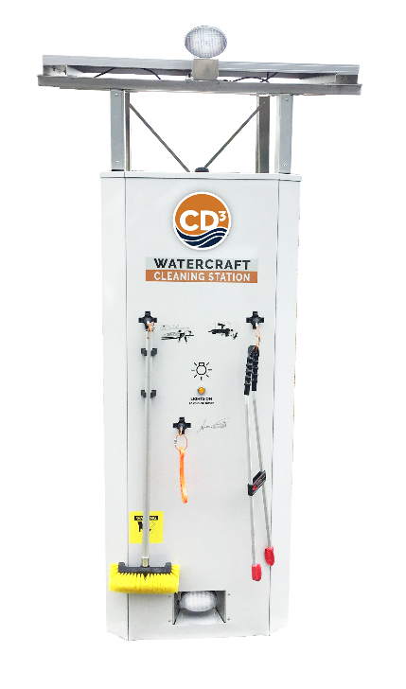
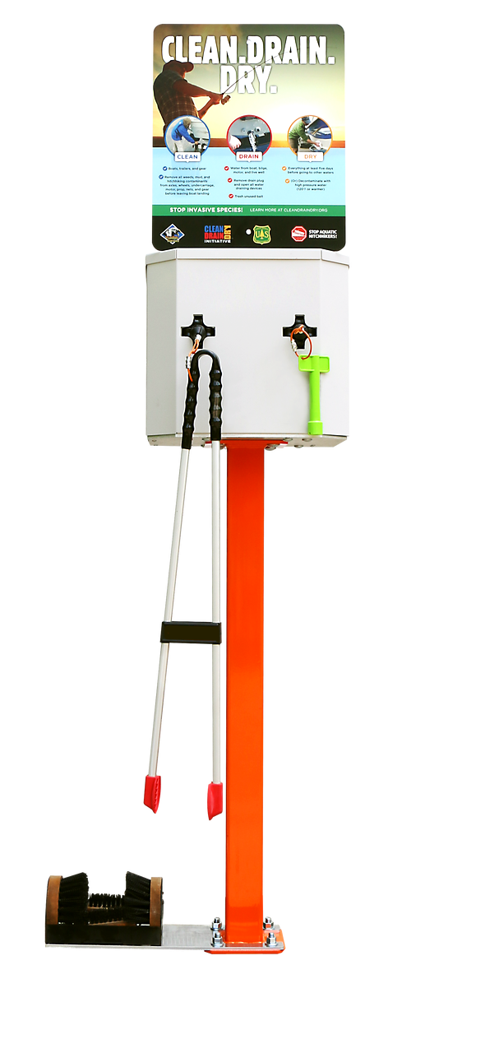
Invasive Species Prevention Models
Roadside Outpost
Wayside Solar

Slide 3
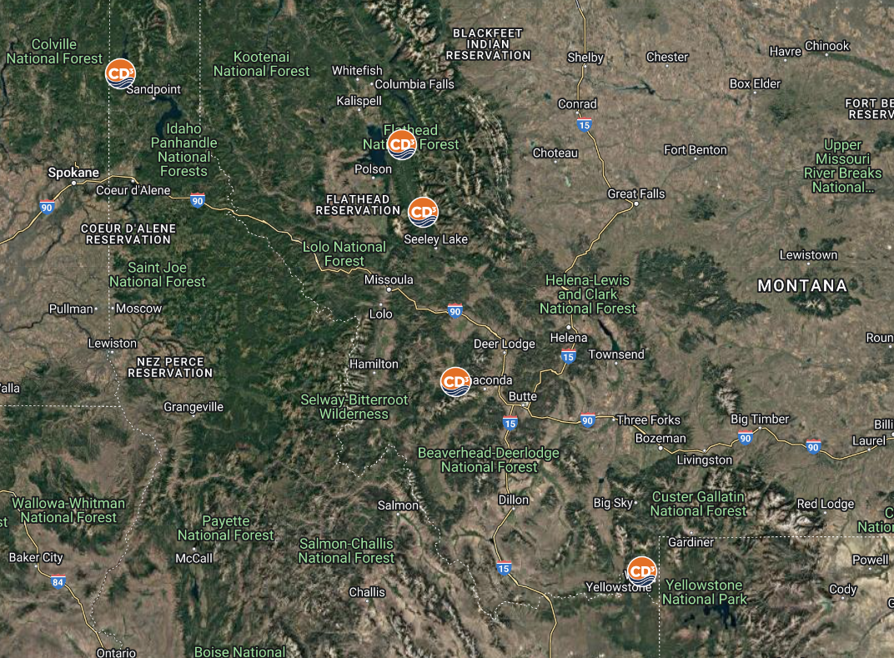
Region 1 Pilot: CD3 Systems Locations
Priest Lake
Georgetown Lake
Swan Lake
Holland Lake
Hebgen Lake
Three Trailhead Pilots
MAP LINK

Slide 4
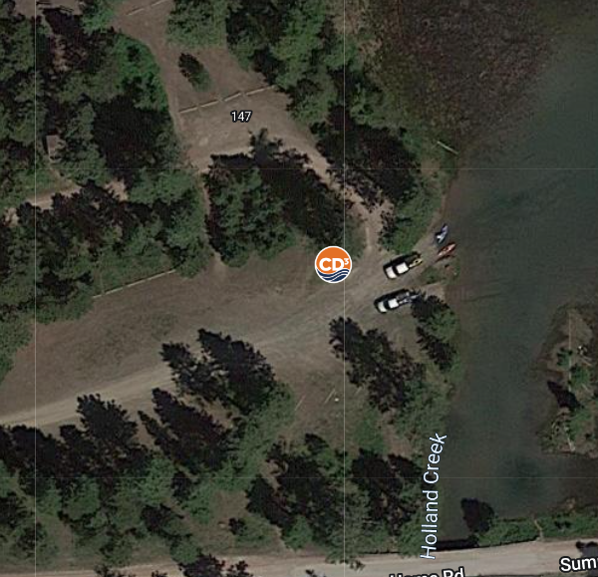
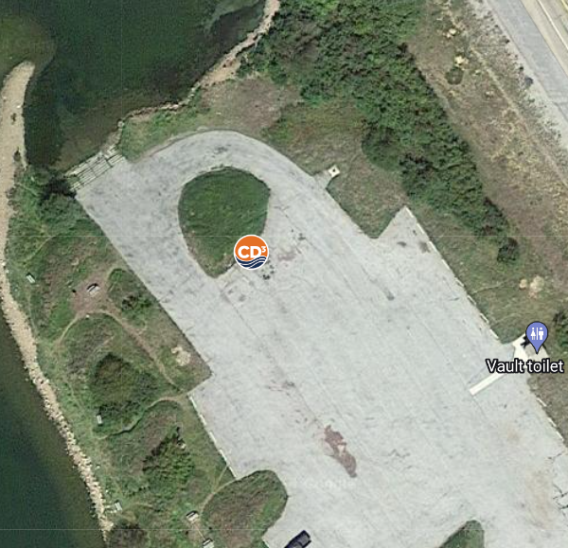
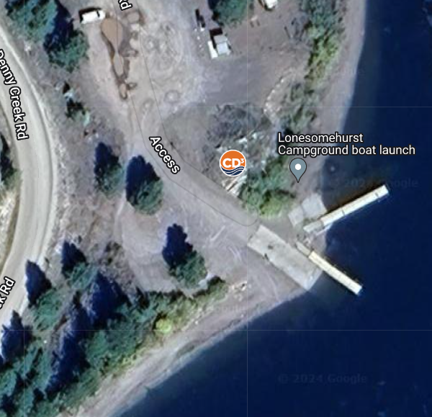
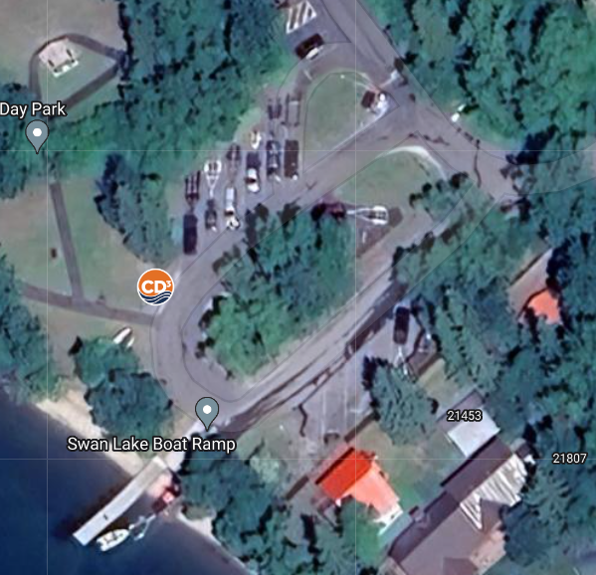
Boat Access
Placement
Install ~200’ of launch
Local signage standards
Use directional arrows
9 out of 10 stop at CD3
Boaters spend 3-5 mins

Slide 5
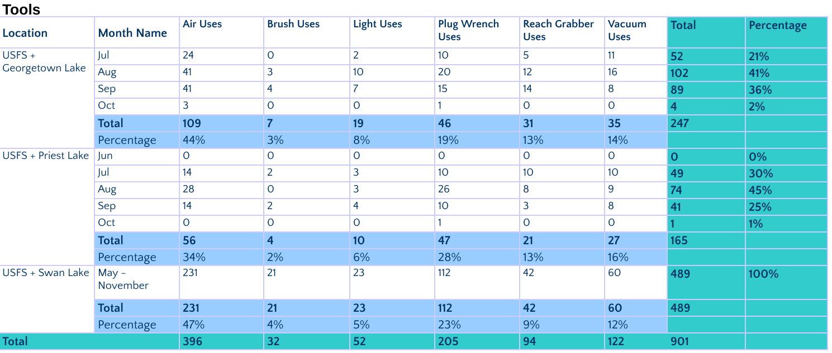
2024 CD3 Tool Use Data (Georgetown, Priest & Swan)

Slide 6
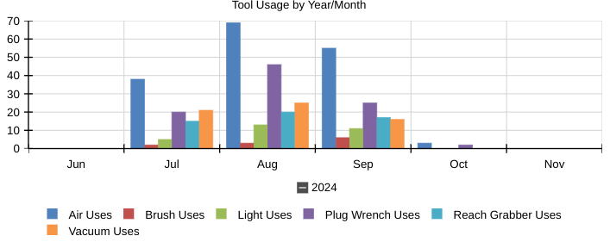
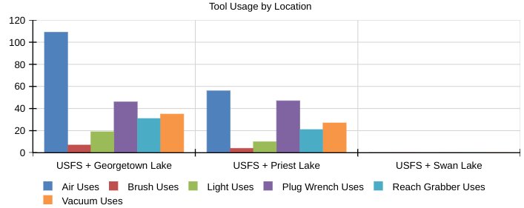
2024 CD3 Tool Tables (Georgetown & Priest)
Tool Usage by Year/Month
Tool Usage by Location

Slide 7
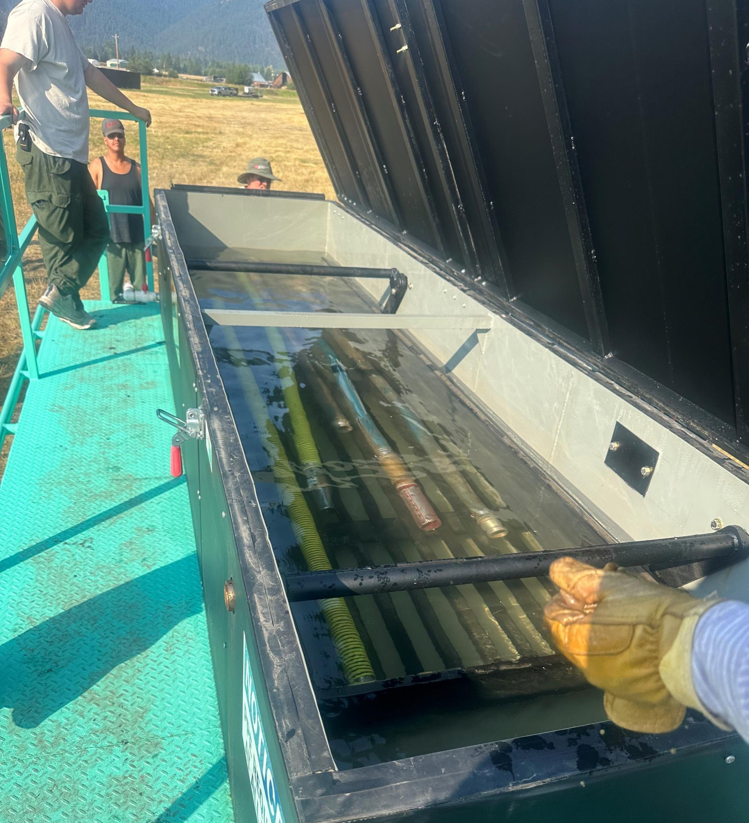
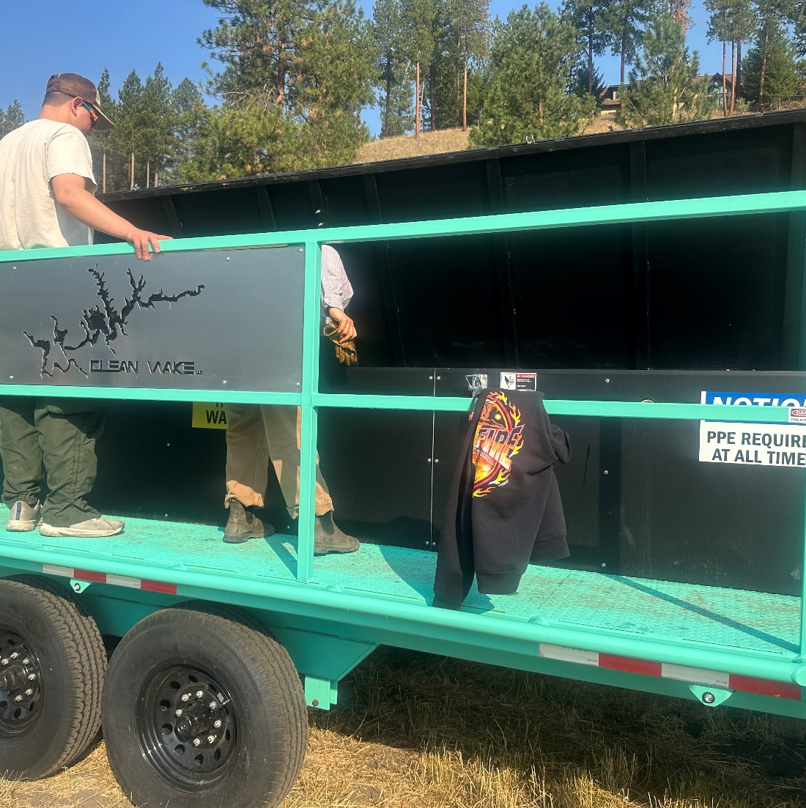
Hot Water Dip Tank
Hoses and footvalves

Slide 8
Next Steps
Development standard operating procedures for ordering the trailer and fuel.
Include a “starter” PPE kit with the trailer with list of items and vendors like Walmart for reordering.
Phase out propane for diesel units because it’s easier to order diesel.
Add an interpretive panel to the trailer.
Plan additional training for operators and Spring Incident Management Team meeting.
How to ensure hot water fills inside of hose.
Add language for ordering AIS decon stations and operators to VIPR

Slide 9
Guide to Preventing Aquatic Invasive Species Transport by Wildland
Fire Operations (2017)
https://www.nwcg.gov/publications/444
How to Guide for the Decontamination of Wildfire Equipment to Prevent the Spread of Invasive Species (2022)
https://gacc.nifc.gov/nrcc/nrcg/index/AIS-How-To-Guide-NRCG.pdf
Training RT-130 Module:
Aquatic Invasive Species Mitigation for Ground Resources
Training RT-310 Module: https://360.articulate.com/review/content/382bff48-e7a3-490f-a6ff- 97c925587565/review
Michelle Cox
USFS R1 Invasive Species Program Manager
Michelle.cox2@usda.gov

