Slide 1
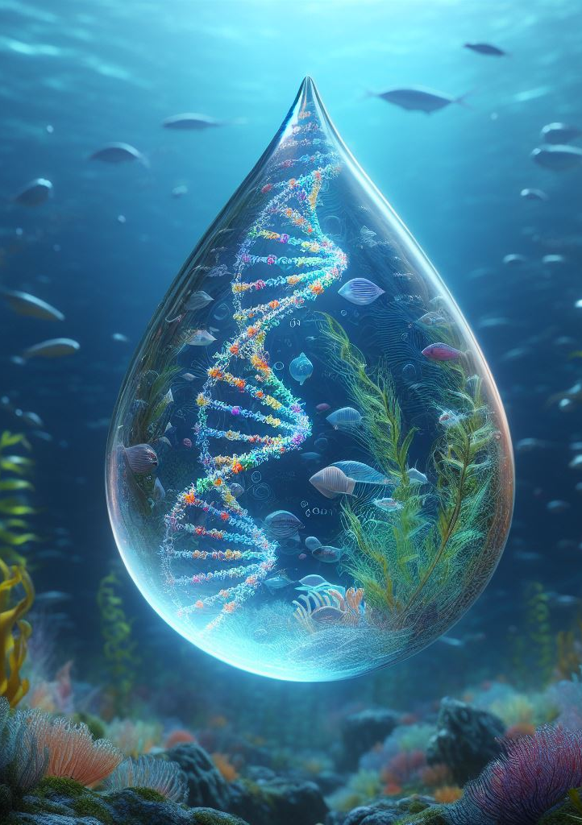
United States National Aquatic eDNA Strategy
Kelly D. Goodwin, NOAA
Chris Meyer, Smithsonian
Mike Weiss, ONR
and
the eDNA Task Team
of the Subcommittee on Ocean Science and Technology (SOST) Biodiversity Interagency Working Group (IWG)
Photo Credit: Zach Gold
Image credit: John Darling*
U.S. Environmental Protection Agency
*with help from Microsoft Image Creator

Slide 2
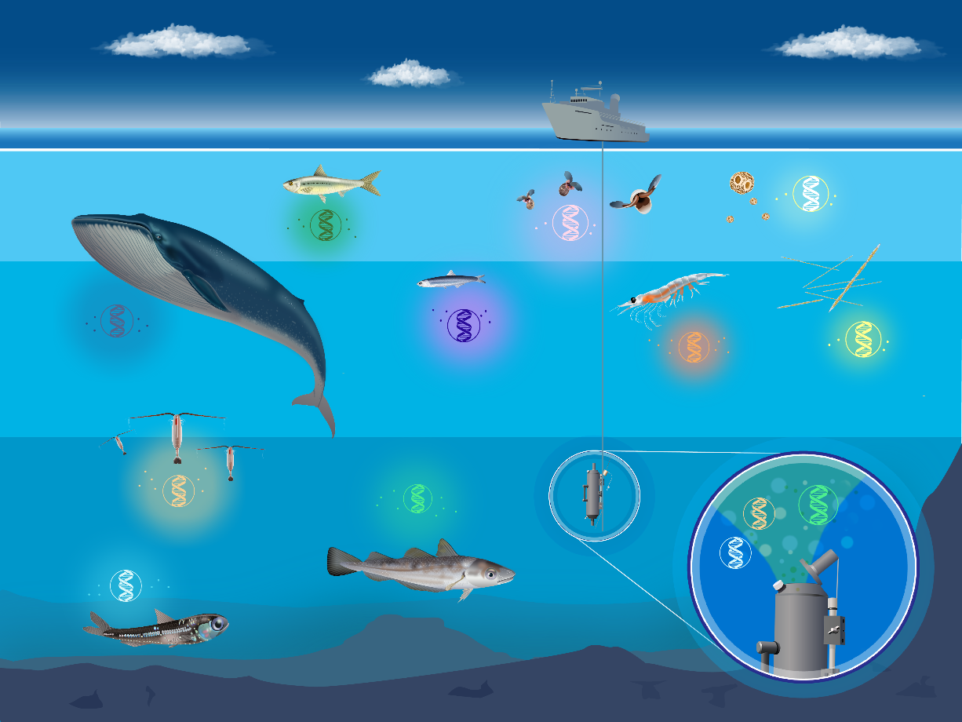
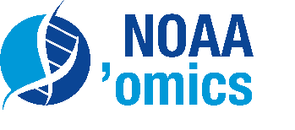
eDNA: a microbes-to-mammals approach to address demand for large-scale biodiversity monitoring
Benefits include:
Easy to collect
Non-invasive
Comprehensive
Cryptic species ID
Can be integrated into autonomous platforms
Image credit: Emily Brown, NOAA

Slide 3
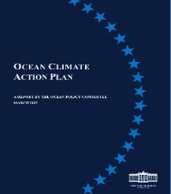
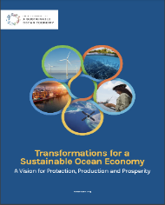
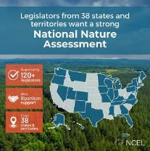
National Demand for Biodiversity Data
Increasing requests for biodiversity data in national policy initiatives, private sector, and internationally.
National Ocean Biodiversity Strategy
National Strategy for a Sustainable Ocean Economy
National Nature Assessment
America the Beautiful (30x30)
National Ocean Mapping, Exploration and Characterization Council Strategic Priorities
National Strategy for the Arctic Region
Notes:
The importance of biodiversity to ecosystem services is reflected in a growing national demand for biodiversity data.
Scientists and managers are increasingly asked for biodiversity data to inform energy development, nature-based climate solutions, the National Nature Assessment, and initiatives like America the Beautiful, National Nature Capital, and strategies focused on the bioeconomy and climate.
All require data on what species and habitats are where, what they are doing, and how they might adapt, move, or degrade in the face of significant environmental change.
The need for credible, actionable, and interoperable biodiversity data is urgent given the intertwined challenges of biodiversity loss, social equity, and climate change.

Slide 4
The Need for a National Aquatic eDNA Strategy
Although the demand is broad, eDNA expertise is localized. Therefore,
National coordination is critical to the production of reliable, credible, and interoperable data.
Shared communication and technical expertise is needed to ensure data collection and interpretation that engender public trust.
Harmonized and trusted analytics are needed to help clarify opportunities for investors and serve as a stimulant for public-private partnerships
A federal role can help accelerate eDNA research and development, encouraging partnerships, and foster job creation in a growing industry of related goods and services.

Slide 5
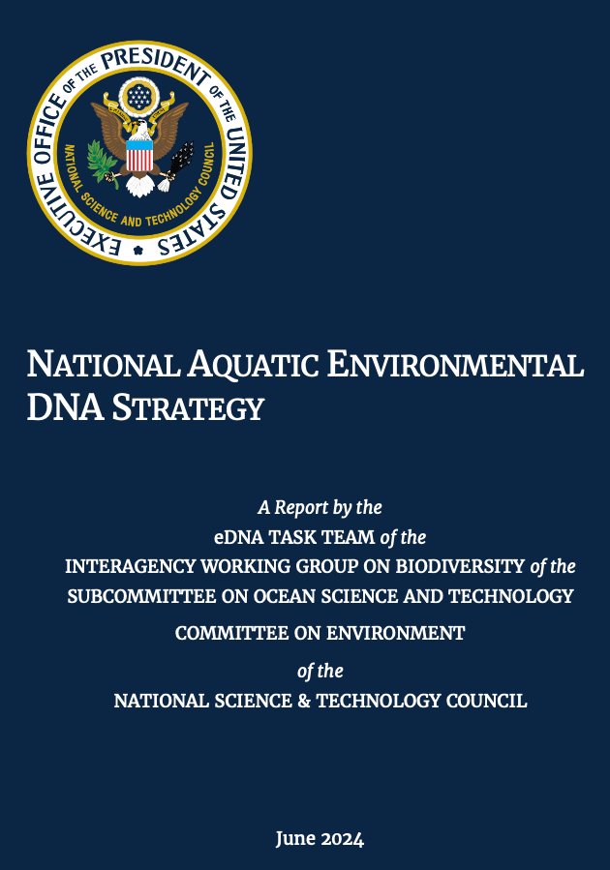
National Aquatic eDNA Strategy
Harness the power of eDNA to explore, map, monitor, and better understand aquatic life to sustain and restore biological resources into the future
Released June 3, 2024
https://www.whitehouse.gov/wp-content/uploads/2024/06/NSTC_National-Aquatic-eDNA-Strategy.pdf
Notes:
Aquatic life includes marine, coastal, estuaries, lakes, rivers, streams

Slide 6
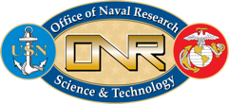
Writing Team Members
Co-Chairs
Kelly Goodwin, NOAA
Chris Meyer, Smithsonian
Mike Weise, ONR
Executive Secretary
Masha Edmonson, UCAR
Katie Fillingham, UCAR
Support
Sarah Weiss, ONR
Writing Team
Meredith Bartron, USFWS
Karen Clark, NIH/NLM
Margaret Hunter, USGS
Richard Lance, USACE
Alyse Larkin, NOAA
Ricardo Letelier, NSF
Cheryl Morrison, USGS
Krista Nichols, NOAA
John Darling, EPA
Amelia-Juliette Demery, NSF
Meredith Everett, NOAA
Zachary Gold, NOAA
Jennifer Gumm, USFW
Kim Parsons, NOAA
Mike Schwartz, USFS
Adam Sepulveda, USGS

Slide 7
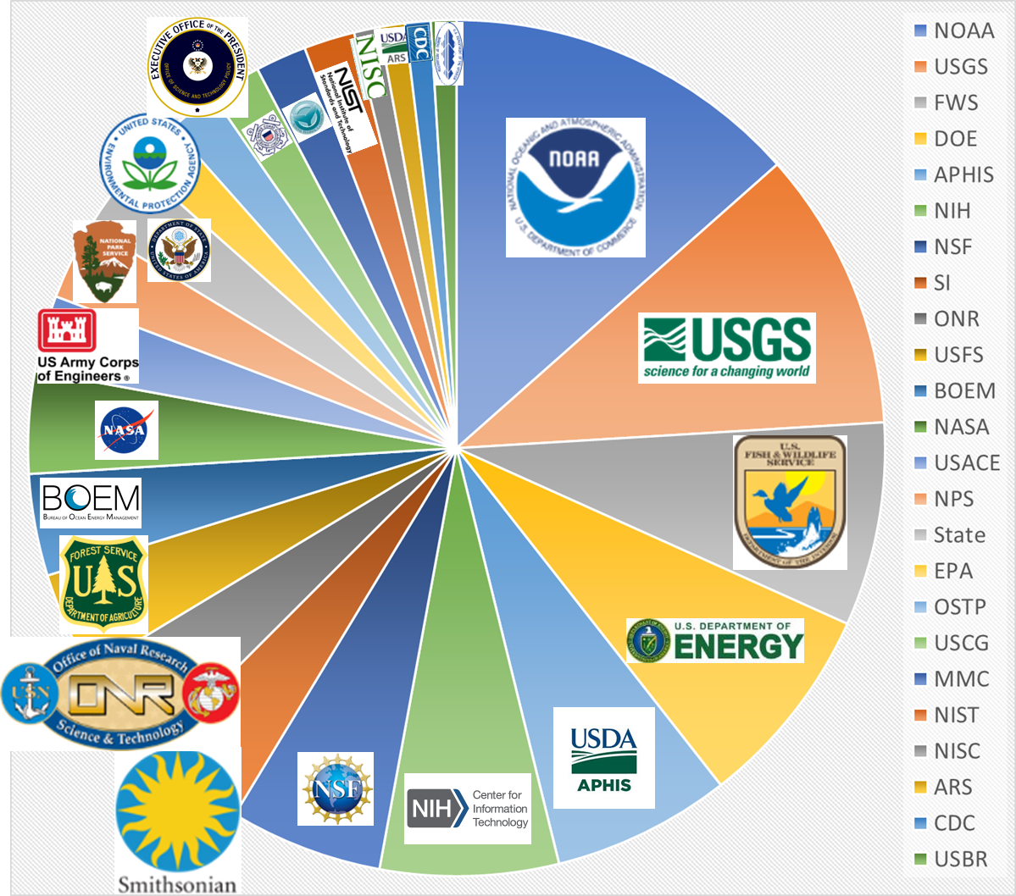
Strategy Engagement
Wide agency participation, representing 24 federal agencies.
Over 100 federal subject matter experts and leaders engaged in review, generating nearly 50 pages of adjudicated comments.
The public response to the Request for Information generated nearly 500 lines of comments that were carefully considered in constructing the Strategy.
Federal review of the National Aquatic eDNA Strategy
Notes:
N=19 hub members
Need:
Although the demand is broad, eDNA expertise is localized. Therefore,
National coordination is critical to the production of reliable, credible, and interoperable data.
Shared communication and technical expertise is needed to ensure data collection and interpretation that engender public trust.
Harmonized and trusted analytics are needed to help clarify opportunities for investors and serve as a stimulant for public-private partnerships
A federal role can help accelerate eDNA research and development, encouraging partnerships, and foster job creation in a growing industry of related goods and services.

Slide 8
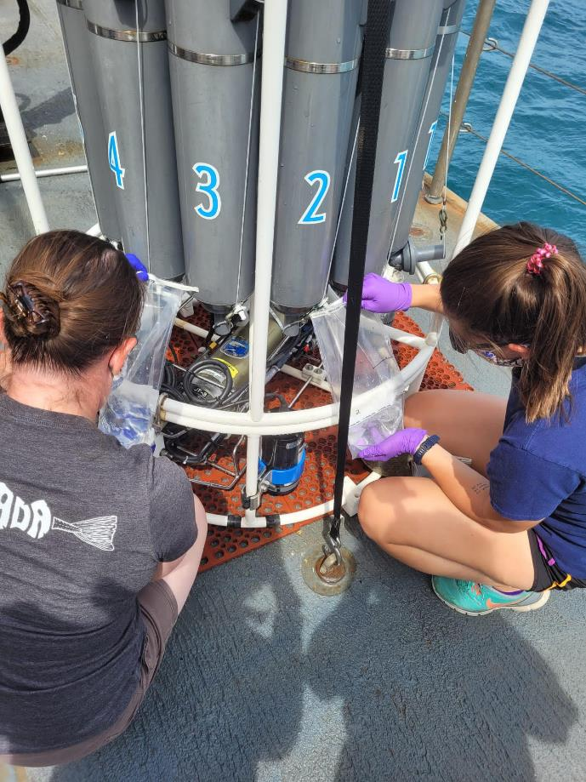
Non-federal Engagement
The submissions to the RFI contained multiple authors, with contributors representing:
Academic Institutions
Commercial Companies
Business Groups
Philanthropic Organizations
Public R&D Agencies
Nonprofit R&D Agencies
Federal Government
State Governments
Local Governments
Partnering non-US Governments
Notes:
RFI closed in December 2023. 27 submisssions

Slide 9
Examples of RFI Feedback informing the Implementation Plan
Support
Provide initiatives and incentives for harmonization, research, innovation, implementation, and partnerships.
Infrastructure
Adequate and interoperable data storage, analysis, visualization, and sharing of data and metadata -- including bioinformatic tools, portals, and databases for ASVs. Seek automated solutions, low-cost sampling solutions, better filtration for dilute targets & turbid conditions.
Technical Consensus
Formalize best practices and protocols for testing and quality checks. Have agreement on acceptable technical assays, monitoring & data practices, and data quality. Include provision of assay metrics, estimates of uncertainty, degree of required replication, and accreditation/validation.
Technical Literacy/ Communicate Readiness
Provide decision support tools and unified communication strategies to help everyone distinguish method readiness to inform appropriateness of the tool for each specific application.
Inclusion
Provide coordination and participation that includes non-federal participants.

Slide 10
Notes:
The focus of Goal 2 is to Build the Human Capacity, the Technical Infrastructure and the Research Enterprise needed to employ eDNA Applications at All Scales
There are 3 Objectives within this second Goal:
Build the Human Capacity via Education and Training
Enhance our existing Infrastructure to Meet the Technical Demands
and
Support Continued Research and Development to Address Priority Science and Technology Needs

Slide 12
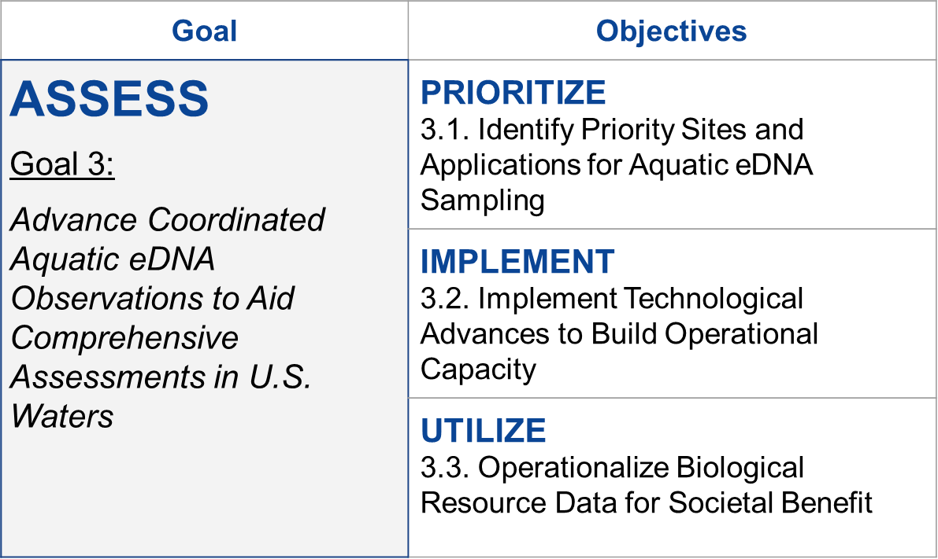

Slide 13
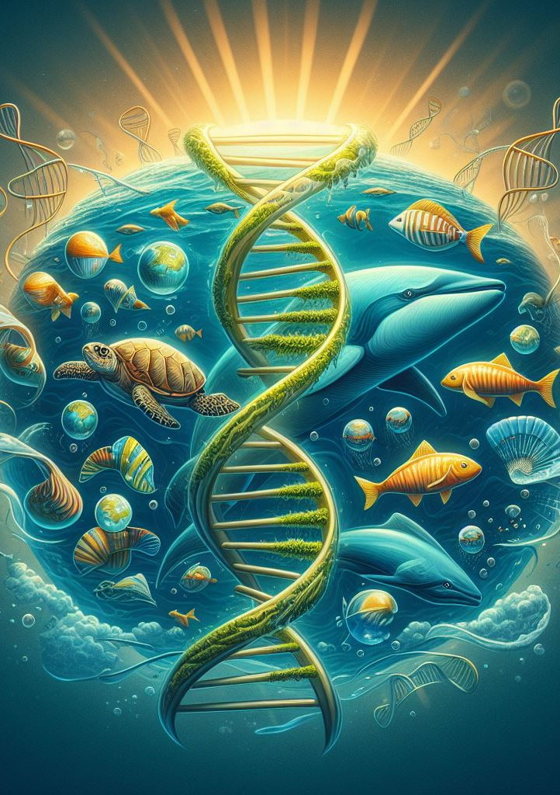
Outcomes
Scaled activities and automated systems provide sufficient coverage and knowledge to
establish robust metrics to inform the status of aquatic health across the nation
allow agencies to better meet mission mandates
increased protection and preservation of U.S. marine and freshwater ecosystems.
Image credit: John Darling*
U.S. Environmental Protection Agency
*with help from Microsoft Image Creator

Slide 14
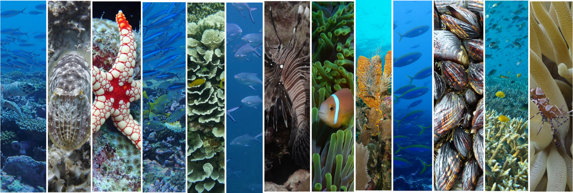
Thank you!

Slide 16
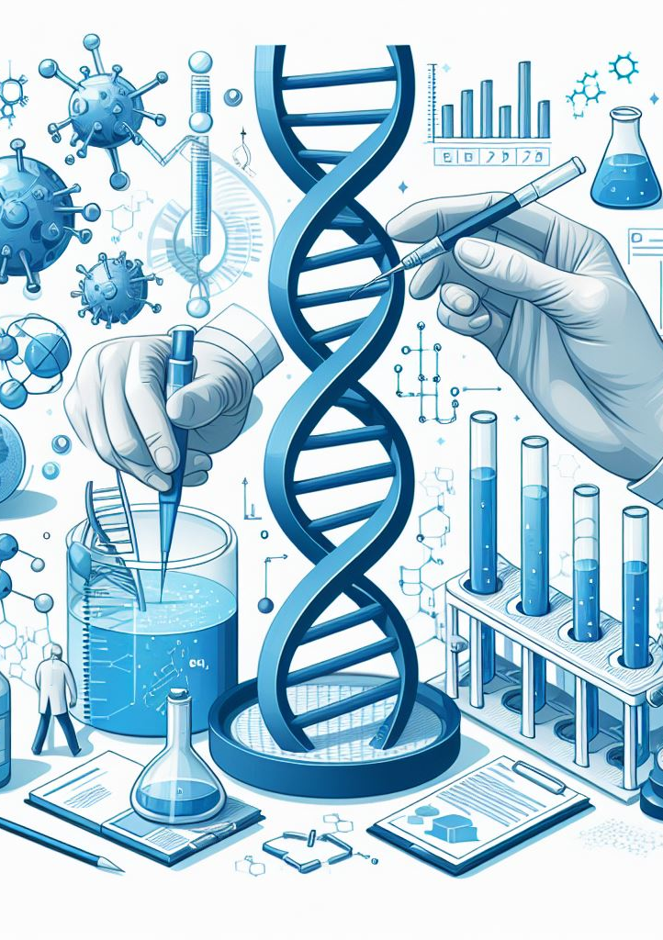
Why do we need standards?
Increase confidence in data and usefulness for resource managers
Provide defense against challenges to decisions based on eDNA data
Facilitate entry into the field
Improve training of new practitioners
Encourage private investment
Notes:
Standards can increase confidence in DNA monitoring data, which makes them more useful in decision-making and management contexts. It also provides a means to defend those data, and the decisions based on them, against challenges, which is critical for usage in regulatory settings. But beyond this standards also facilitate entry into the field by providing clearly accepted methods for new users to adopt and to facilitate training of new practitioners. They also spur private investment, providing potential service providers with license to operate and potential customers with reason to trust them. This is key to broadening the user base and opening up new markets.

Slide 17
Where are we headed?
International eDNA Standardization Task Force
Notes:
There is an effort led by a relatively new group, the International eDNA Standardization Task Force (iESTF), which was established to leverage resources across the eDNA community of practice to develop international standards for DNA monitoring. The major practical output of this group has been establishment of a new working group of the International Organization for Standardization, which is tasked with developing formal, international standards for sampling, capture, and preservation of eDNA from aquatic samples. This is a screen shot from the ISO webpage referencing this effort, which currently doesn’t say much more than “under development.”

