Slide 1

Montana Update

Slide 2
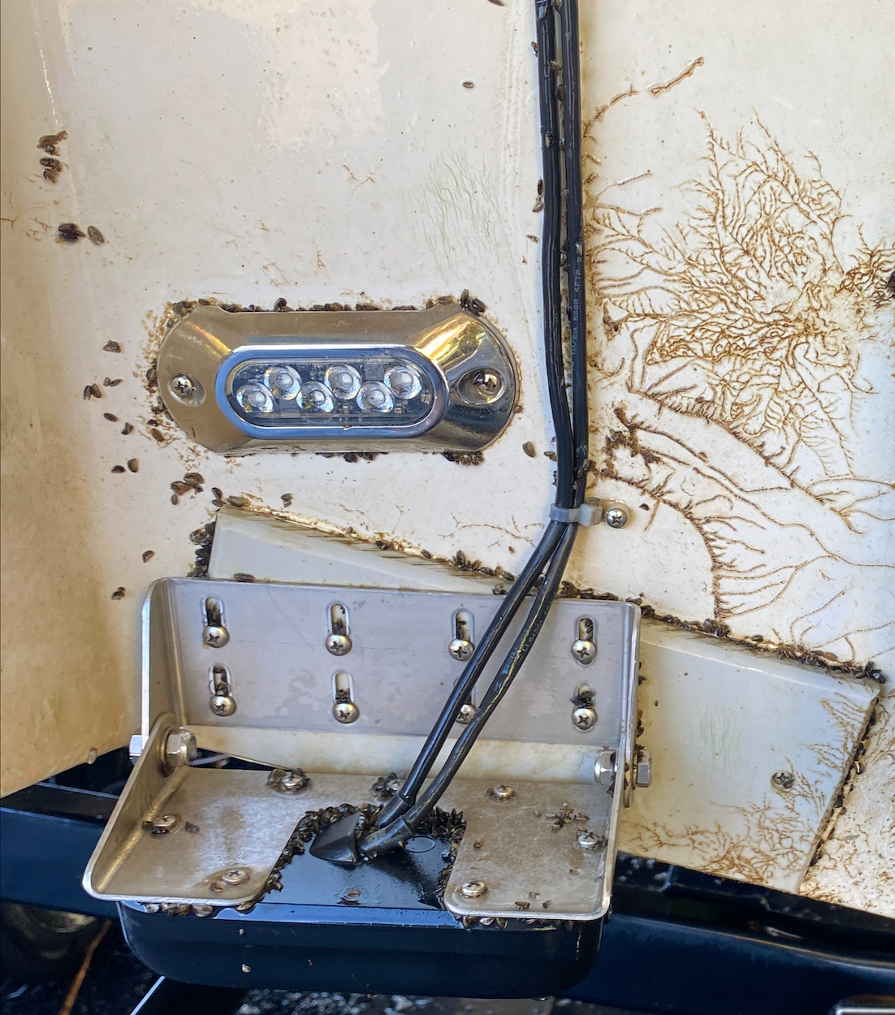
Montana AIS 2024
123,000 watercraft inspected
  47 Mussel fouled vessels.
  Over 500 with weeds.
  BIG Project: Over 97% boater compliance at boat ramps.
  FWP staff supported SDGF inspections at Pactola Reservoir.
Over 3,000 AIS early detection samples collected.
  Microscopy
  eDNA
No evidence of mussels detected.

Slide 3










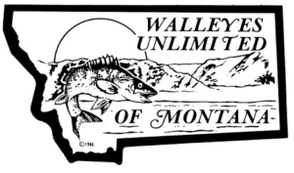













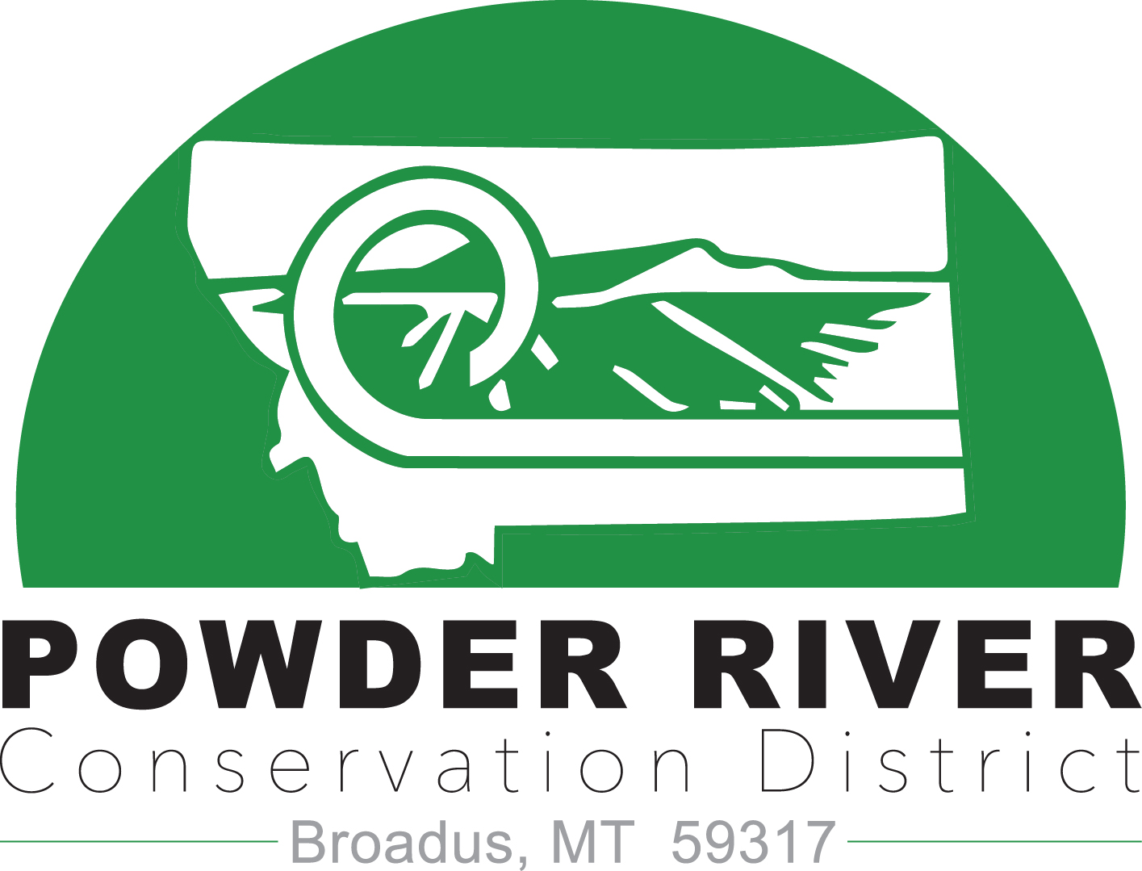
AIS Partners

Slide 4
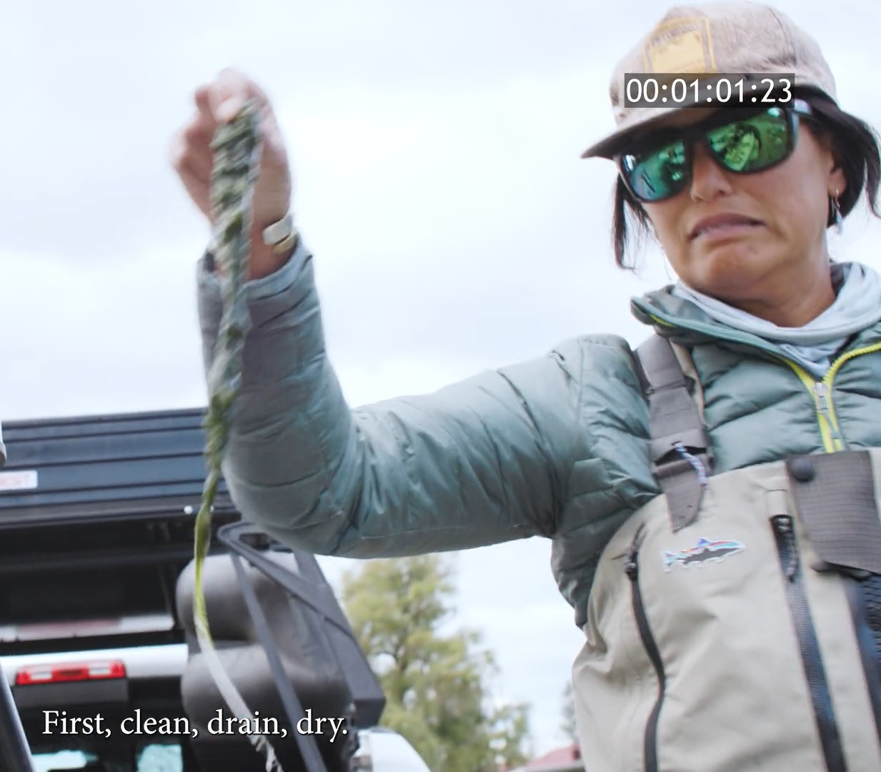
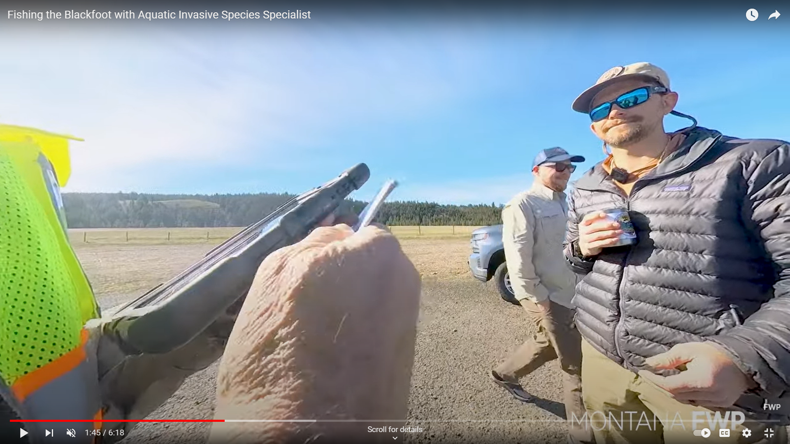
Outreach Videos
Google: FWP YouTube

Slide 5
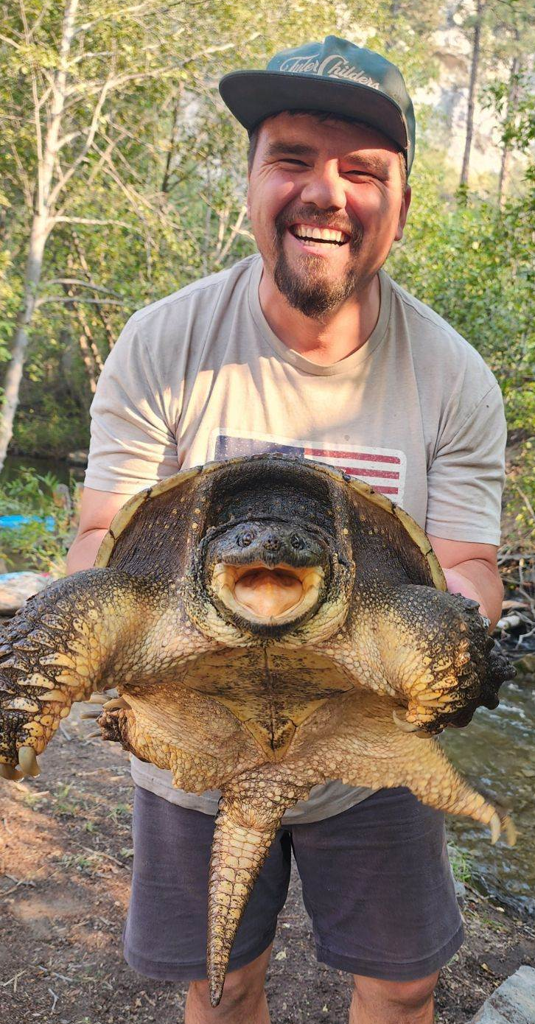
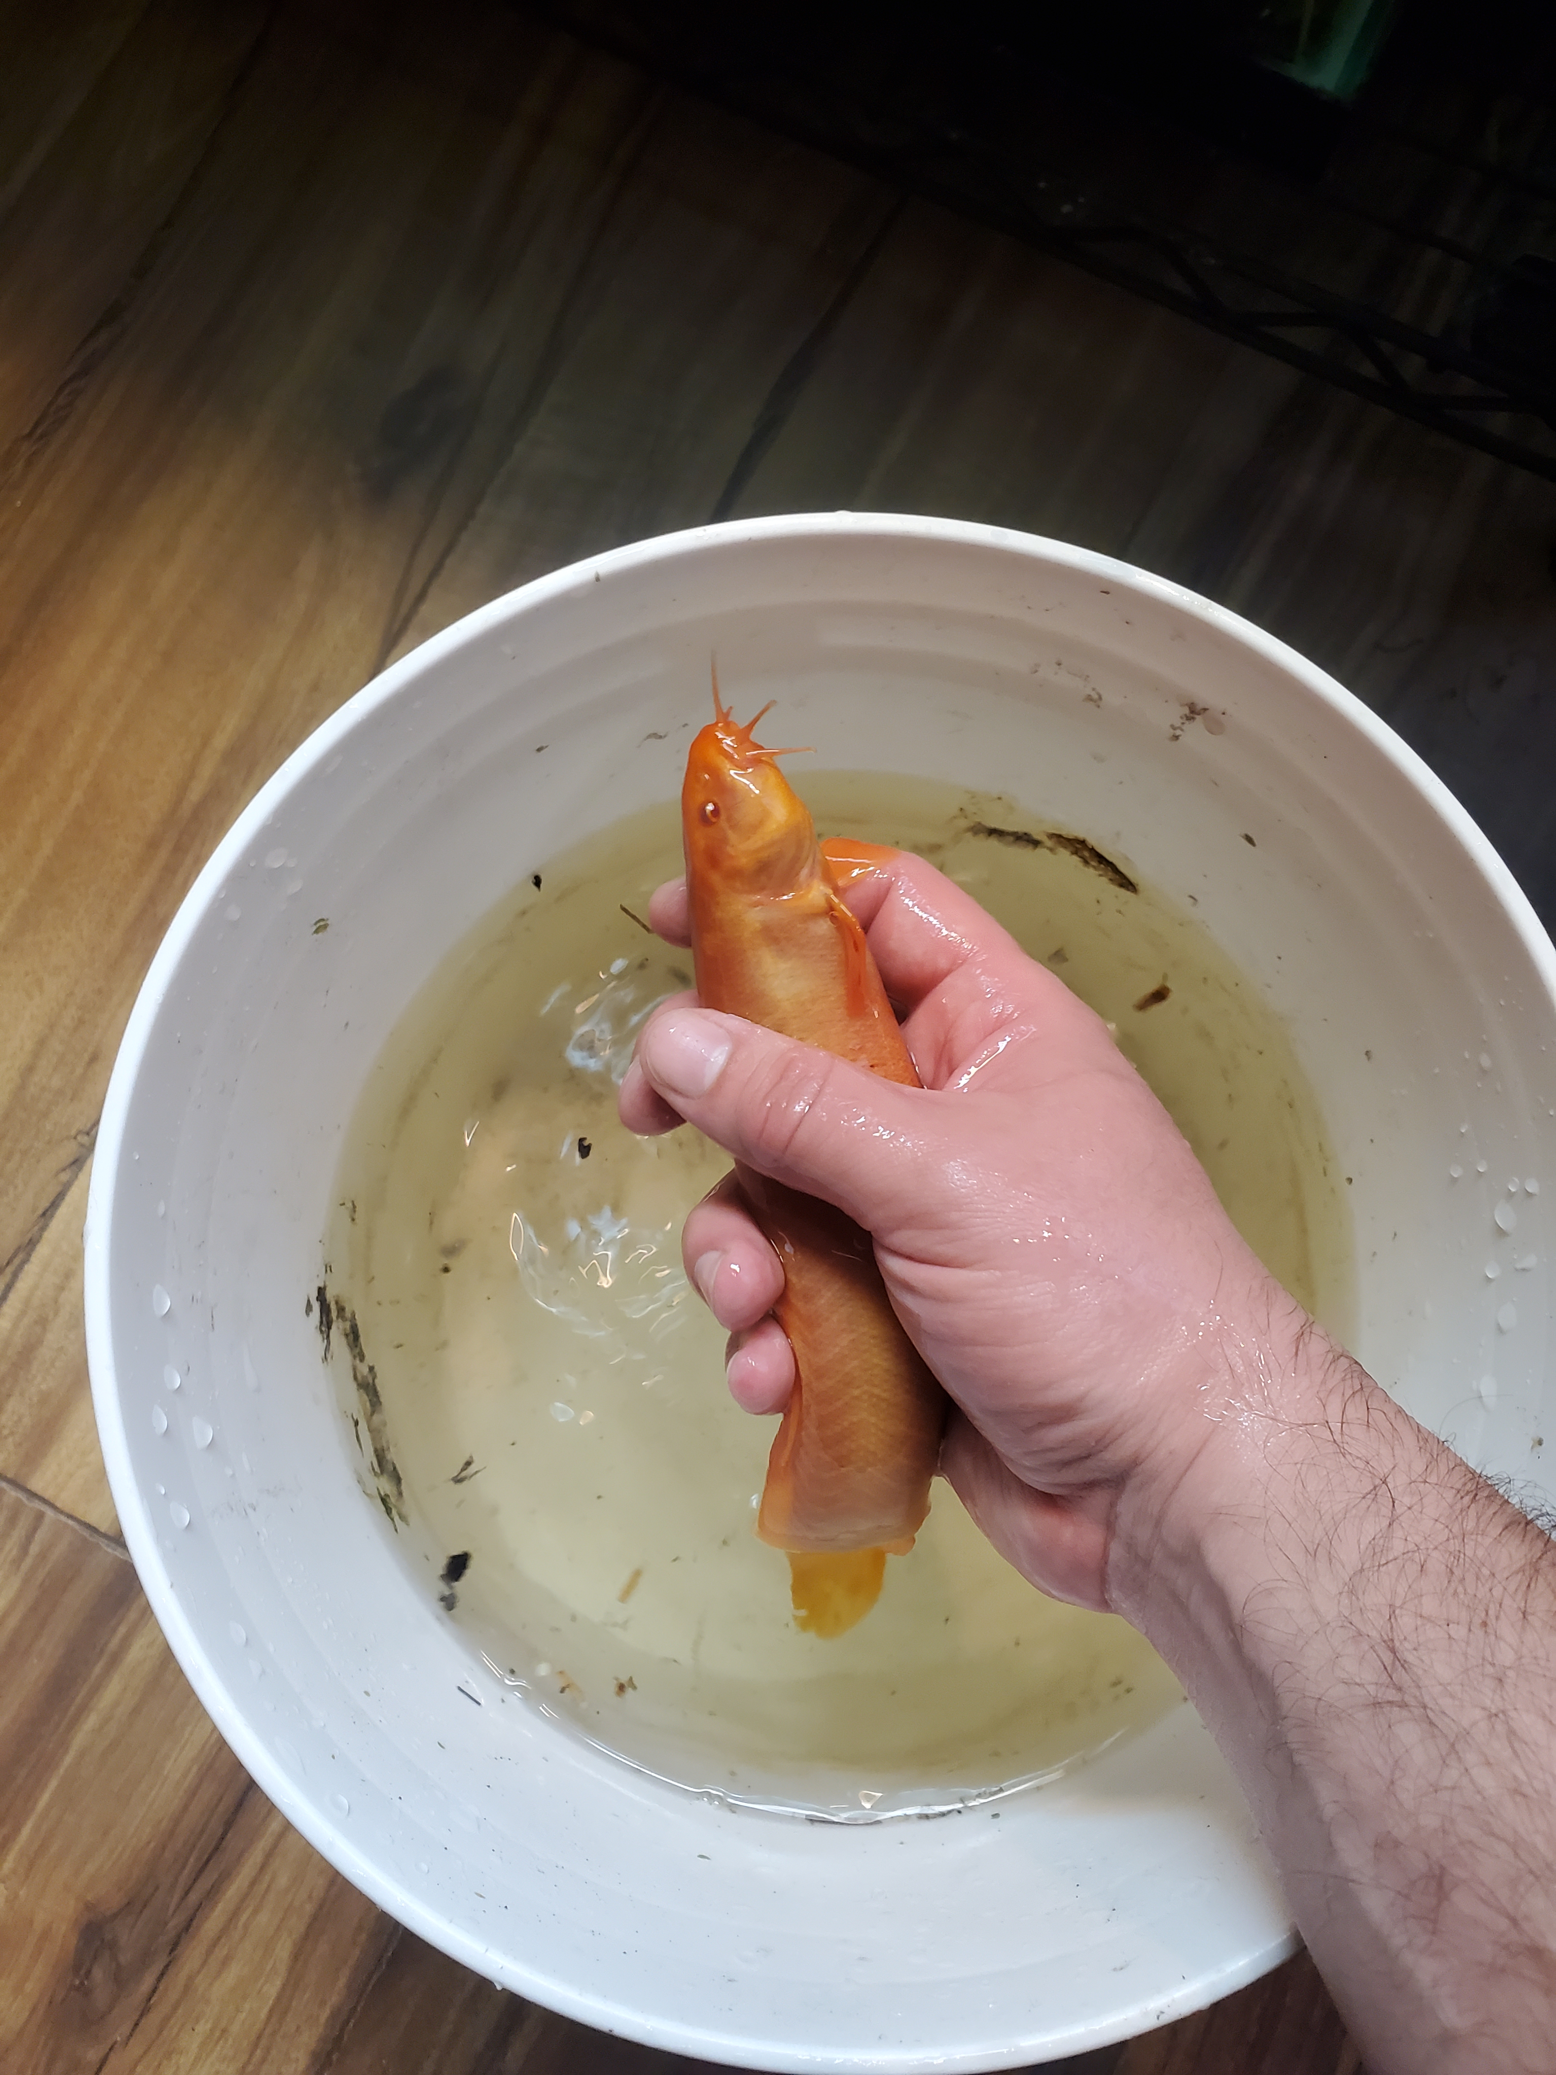

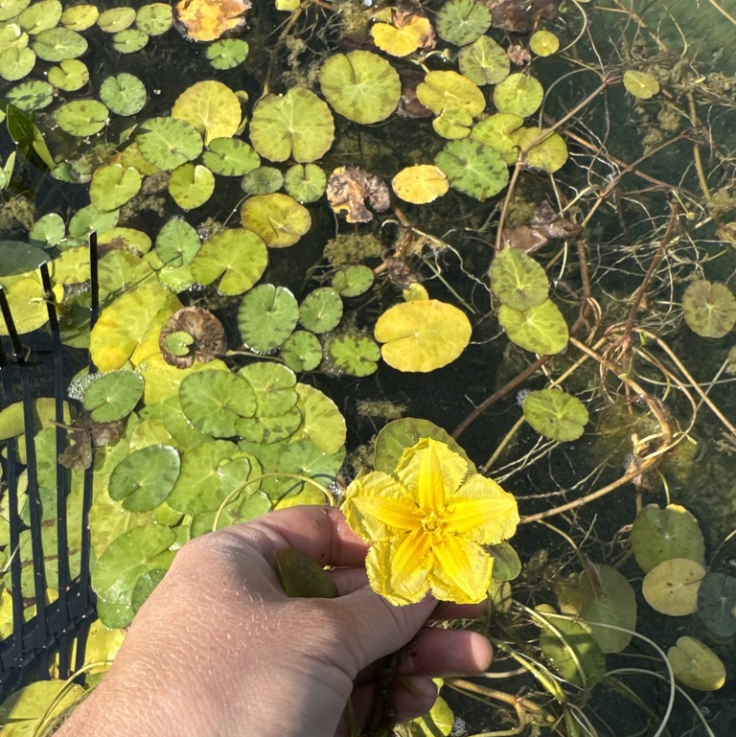
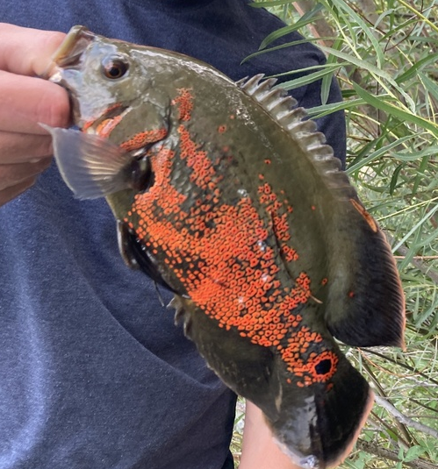
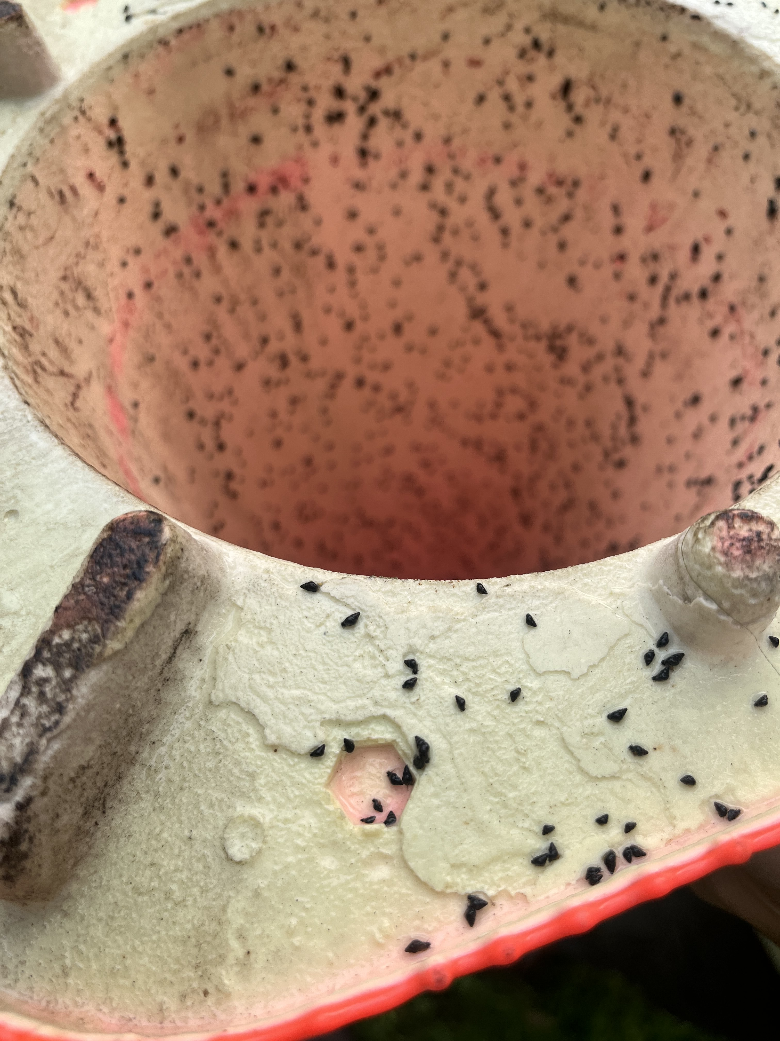
Expanding Public Reporting
Encourage public survey and reporting.
I-Naturalist, The Montana Natural Heritage Program and FWP website.
Many new reports in 2024.

Slide 6
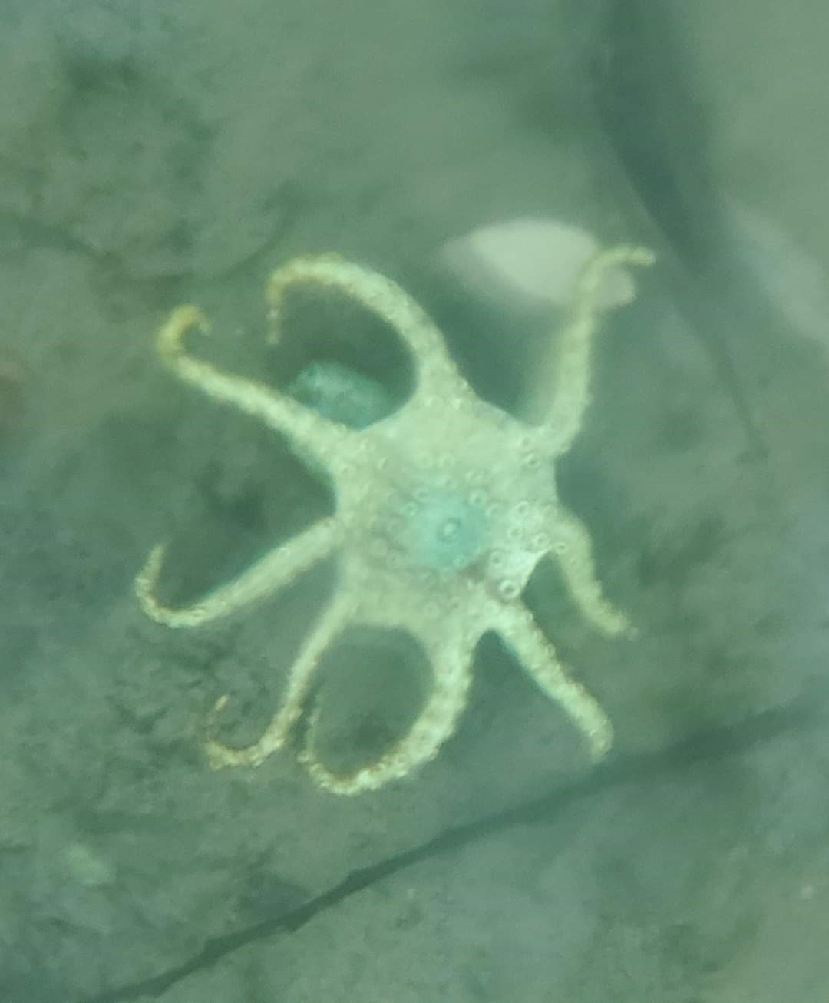
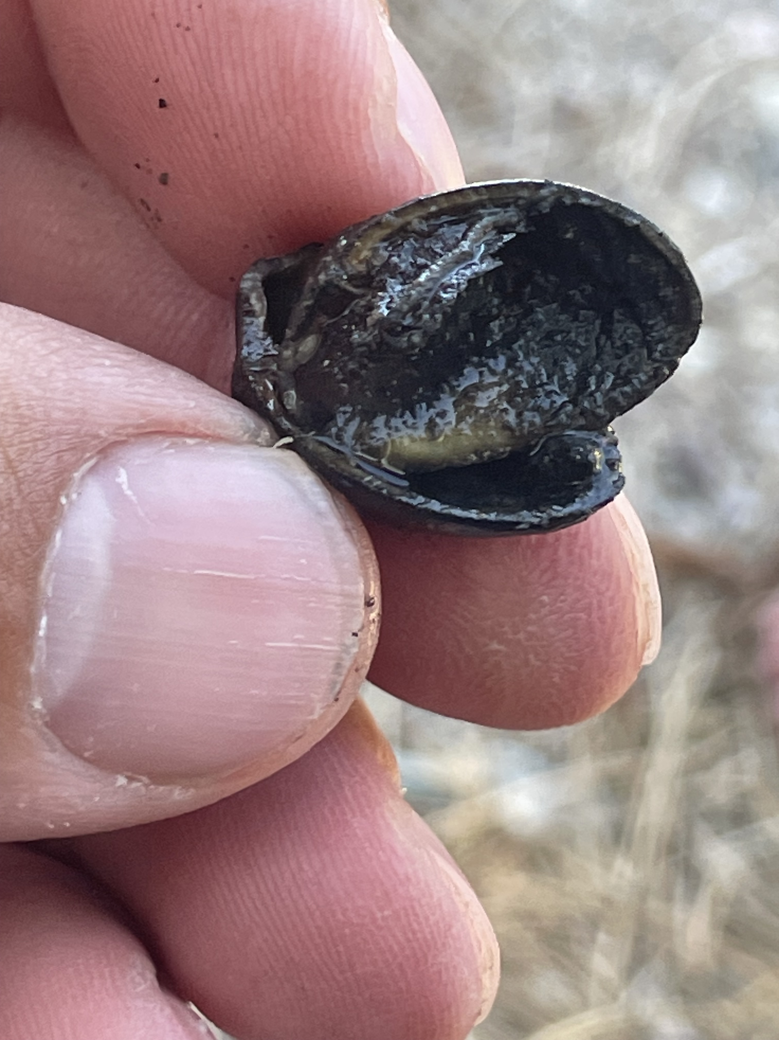
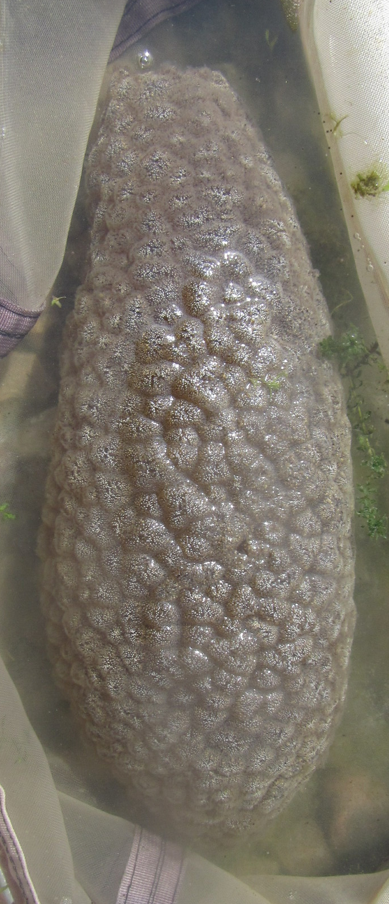
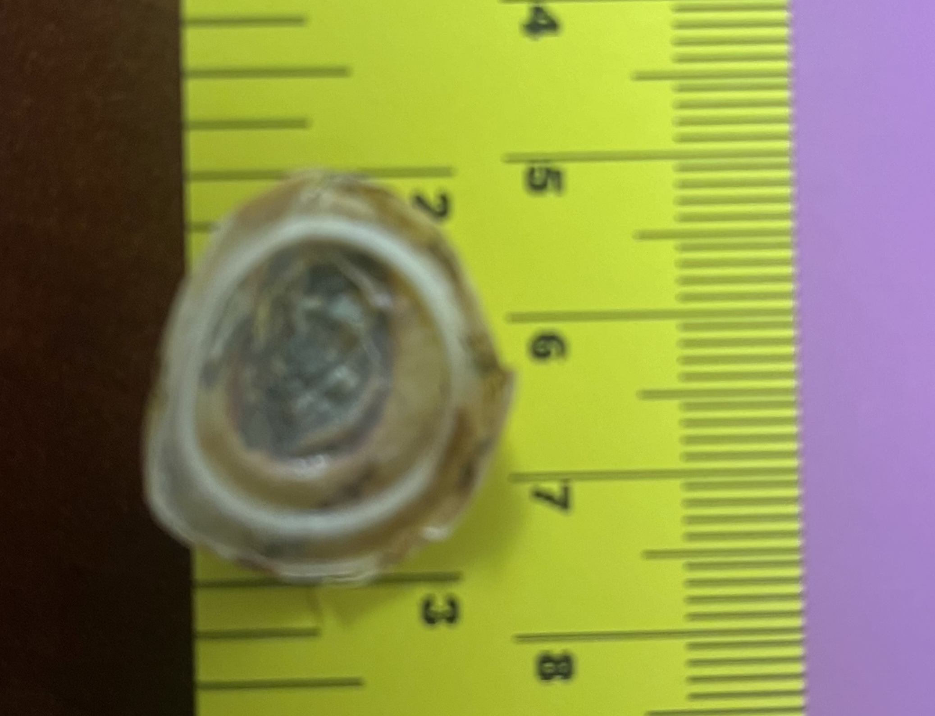
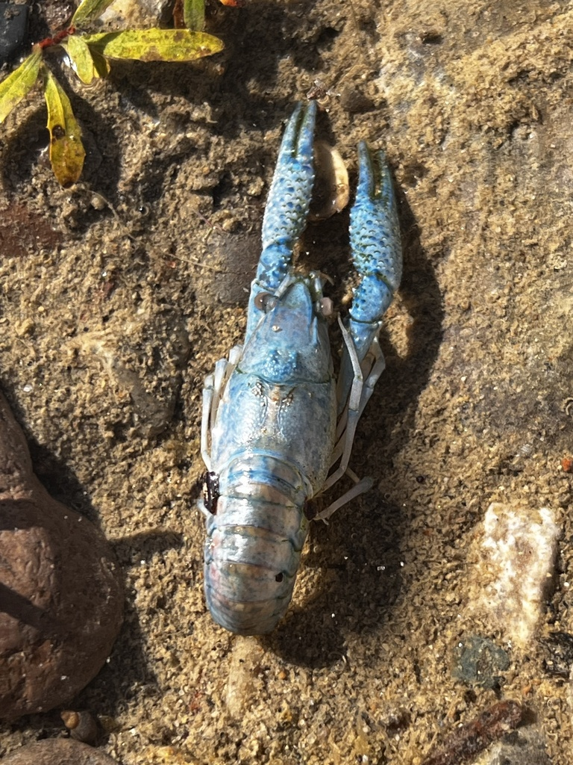
Other Public Reports

Slide 7
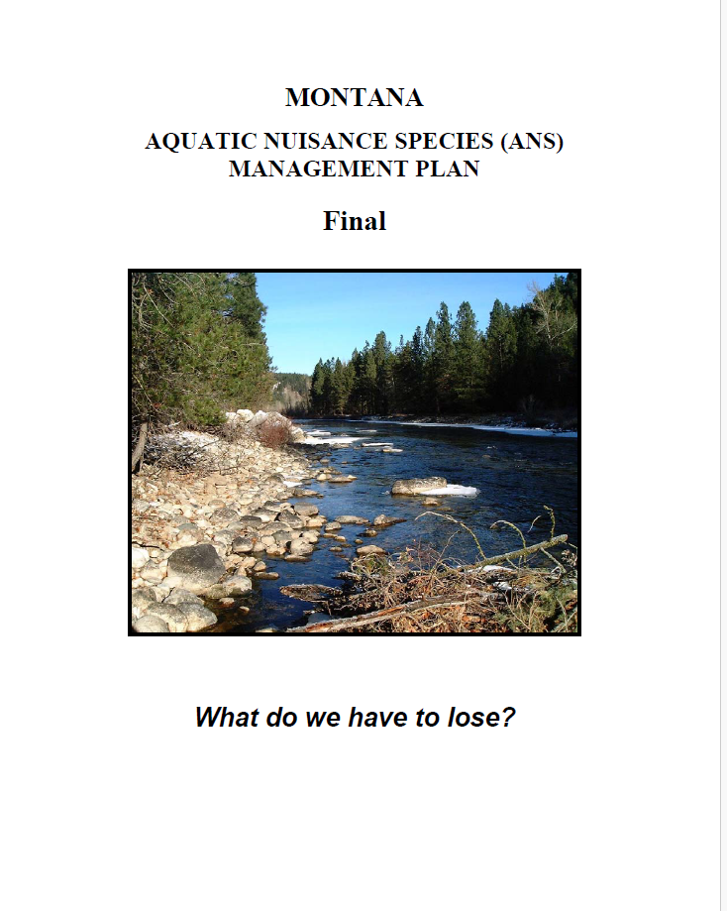
Updating Montana’s AIS Plan
Last updated in 2002.
Public comment open in December.
Approval by ANSTF by late 2025.

Slide 8

Plans 2025
No anticipated changes in legislation or budget.
Improve inspection compliance in the Greater Yellowstone area.
Continue to address QA/QC.
Highlight on-the-ground efforts.
Expand partner involvement with outreach.

Slide 9
