Slide 1
Washington’s Watercraft Inspection and Decontamination Section 2024 Update Columbia River Basin 100th Meridian Conference
Susan Brush (she/her)
Watercraft Inspection and Decontamination Section Lead
December 10th, 2024
Notes:
Hello, I’m Susan Brush. I’ve been in my as role Watercraft Inspection and Decontamination Section Lead for The Washington Department of Fish and Wildlife for about four months now. My primary duties are to oversee the contracts, agreements and budget management of the WID Program as well as develop strategic planning for our Watercraft Inspection Station operations.

Slide 2
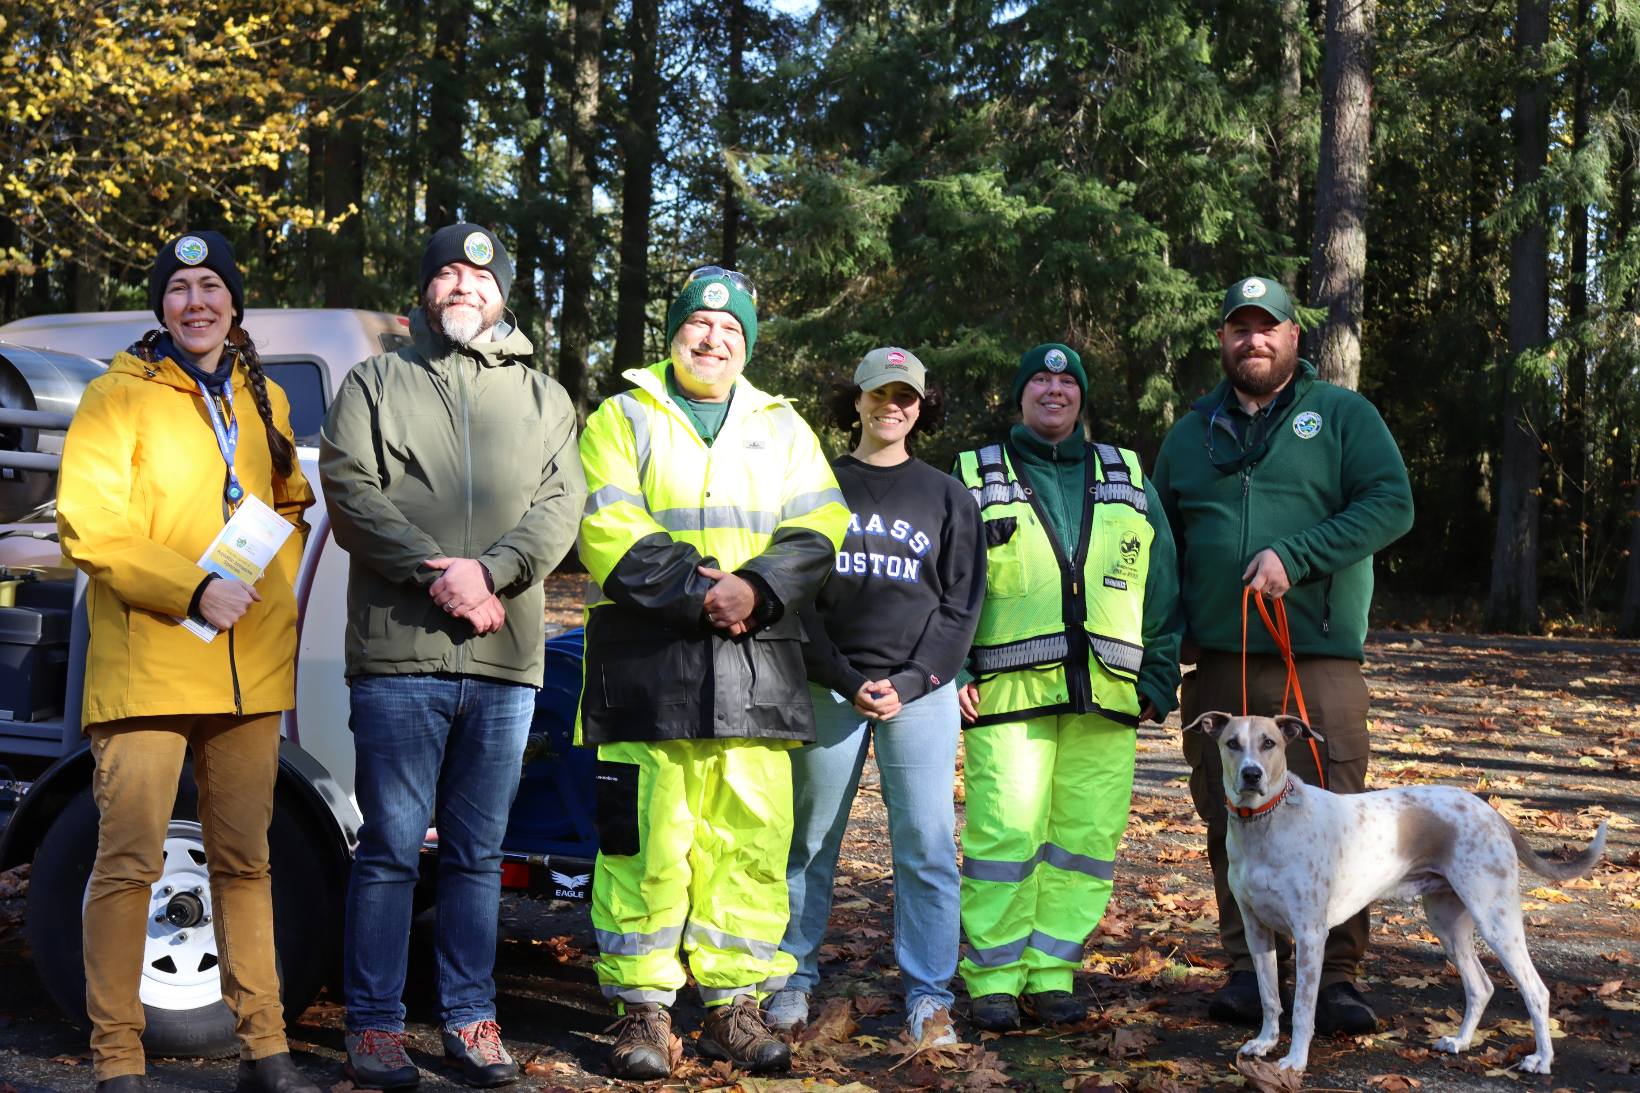
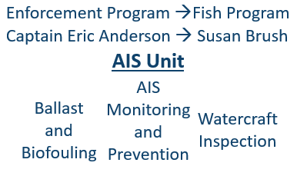
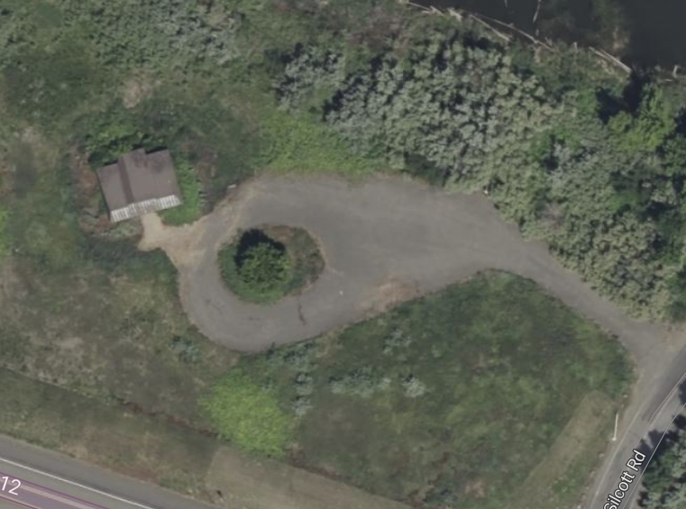
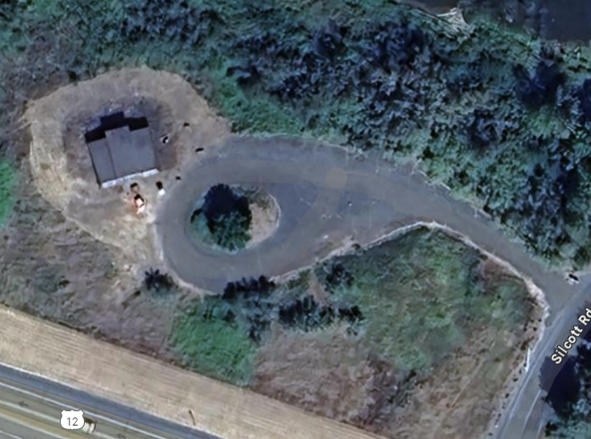
WID Section 2024 Activities:
Clarkston Inspection Station Before and After:
Aquatic Invasive Species Unit Staff: Susan Brush, Justin Bush, Cory Geisler, Rachel Flannery, Ashley Orr, Nicholas Knauss, and Fin (Canine) .
Year | Watercrafts Inspected | Decontaminations performed | Mussel Fouled watercraft
YTD 2024 (12/1/2024) | 54,100 | 2,096 | 13
Former Chief Timothy Building before and after the removal of 85 cubic yards of blackberries.
Notes:
2024 was a big year for Washington’s Watercraft Inspection and Decontamination Section. In July, the staff moved from under Washington Department of Fish and Wildlife’s Enforcement Program to the Fish Program under the Aquatic Invasive Species Unit. I came on staff in August in a newly created role dedicated to the WID section. These changes were implemented to optimize DFW’s ability for a coordinated rapid response should invasive mussels be detected in Washington’s waters.
The first big take away or lesson learned that I have from 2024, is how important this newly created role is. Long-term infrastructural changes take time and require concentrated efforts. An example would be our new permanent inspection station in the Southeast of the state in Clarkston, WA. This station was set up, cleared of blackberries and developed for inspection activities at the beginning of this year. A primary concern as the season was underway was that we lacked adequate signage from the highway to instruct boaters of the requirement to be inspected. I have been working with our partners at Washington State Department of Transportation, assembling all required parties, confirmation of design, identifying work crew for installation and connecting contract employees from both agencies to have eyes on this work order since September, and we are *almost* there! Then, the reward, once finished, will be to turn our attention to another location.

Slide 3
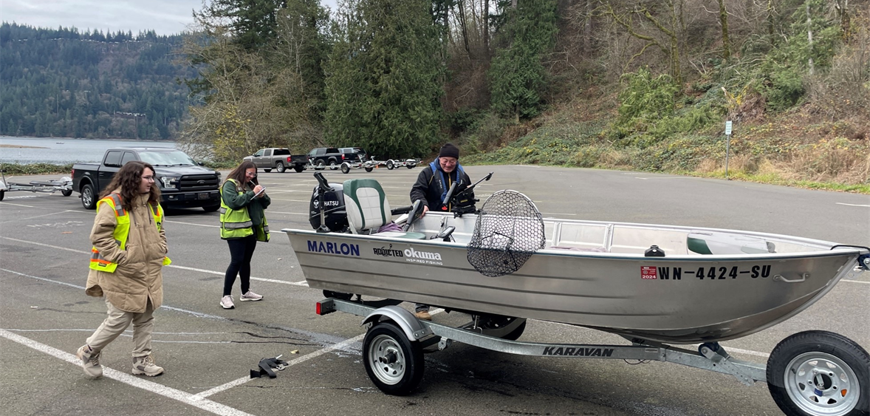
WID Pilot Station: Newport HWY
Expanding Inspection Activities in 2025
Optimizing Ridgefield Inspection Station
Evaluating existing site capacity
Developing appropriate signage
Map and Site map of Pilot Inspection Station Site shared with Chronic Wasting Disease staff.
Ridgefield Roving Team performing watercraft inspection
Notes:
We have two big activities on the horizon for 2025. The first is the launch of a new pilot station in NE Washington along the boarder between Washington and Idaho near Chatteroy. This pilot station will be fulfilling dual needs, the first to determine number of boaters for this transportation corridor that may potentially be circumventing our flagship, Liberty Lake/Spokane Station. The second, providing an additional level of protection to Lake Roosevelt Recreational Area. We have partnered for use of this inactive former weigh station with Washington State Highway Patrol and intend on sharing it’s use with the Department of Fish and Wildlife’s Habitat Program’s Chronic Wasting disease survey.
Our second big activity for 2025 will be optimizing watercraft inspection activity in Southwestern Washington. Ridgefield staff have been in a roving capacity this last year, due to restricted ability to provide adequate signage at our Port of Entry location. We will be re-evaluating this site to determine if it will meet our long-term capacity needs and work with our Washington State Highway Patrol partners to set ourselves up for better site visibility in the upcoming season.

Slide 4
Looking Forward:
Investing in existing infrastructures.
Ensuring staffing needs are met.
Implement cohesive communications branding.
Establishing ongoing Funding:
2025-2027 agency budget request for ongoing increased state funding.
Response Readiness
Notes:
I am excited to begin this work for next year with a dedicated communications staff for our Aquatic Invasive Species Unit through June 2025 to help us with our cohesive design branding and increased visibility needs for the WID Section. Our Watercraft Inspection Stations play a pivotal role in prevention and look forward to connecting our stations with expanded resources to conduct this important work.
Currently, Washington Department of Fish and Wildlife is requesting a legislative appropriation for Aquatic Invasive Species and ongoing funding for response. As a unit we are very hopeful that this award would secure us with the necessary funding to continue strategic planning and further development of our response and readiness planning. Recent continued detections in Idaho of Quagga veliger’s and California’s expanding Golden mussel response illustrates our states increased prevention needs.

Slide 5
Questions?
Susan Brush (she/her)
Watercraft Inspection and Decontamination Section Lead
Aquatic Invasive Species Unit
susan.brush@dfw.wa.gov
(564) 250-0667
Notes:
I’ll do my best to answer any questions you have with our remaining time.

