Slide 1
Potash as an epa-approved treatment for dreissenids
100th Meridian Columbia River Basin Team Meeting
10 December 2024
L. DeBruyckere

Slide 2
List of commonly used chemicals approved for dreissenid control is limited
Copper compounds
EarthTec QZ
Natrix
Cutrine Cultra – chelated copper
Copper sulfate
Zequanox
Others . . .

Slide 3
Copper compounds and salmonids Upper recommended limits (ferguson and Sandoval 2020) <0.03mg/l in hard water <0.0006mg/l in soft water
Copper:
Is one of the most toxic heavy metals to fish (Nowak and Duda 1996)
Is A neurobehavioral toxicant that disrupts the fish olfactory system (Hara et al. 1976)
Interferes with the ability of fish to detect and respond to chemical signals (Sandahl et al. 2004)
Impairs gill gas exchange, upsets salt balance, affects reproductive output and the immune system, affects glucose metabolism and the cellular structure of fish, and negatively affects liver and kidney function (Ferguson and Sandoval 2020).
Can disturb ion regulation and ammonia excretion when fish are acutely exposed (Macpherson and Cremazy 2024).
Steelhead exposed to concentrations of 5 and 20 µg/L for 3 hours exhibited loss in olfactory function (Baldwin et al. 2011)
Sensory physiology and predator avoidance behaviors of juvenile coho were significantly impaired by copper concentrations as low as 2 µg/L (Sandahl et al. 2007).

Slide 4
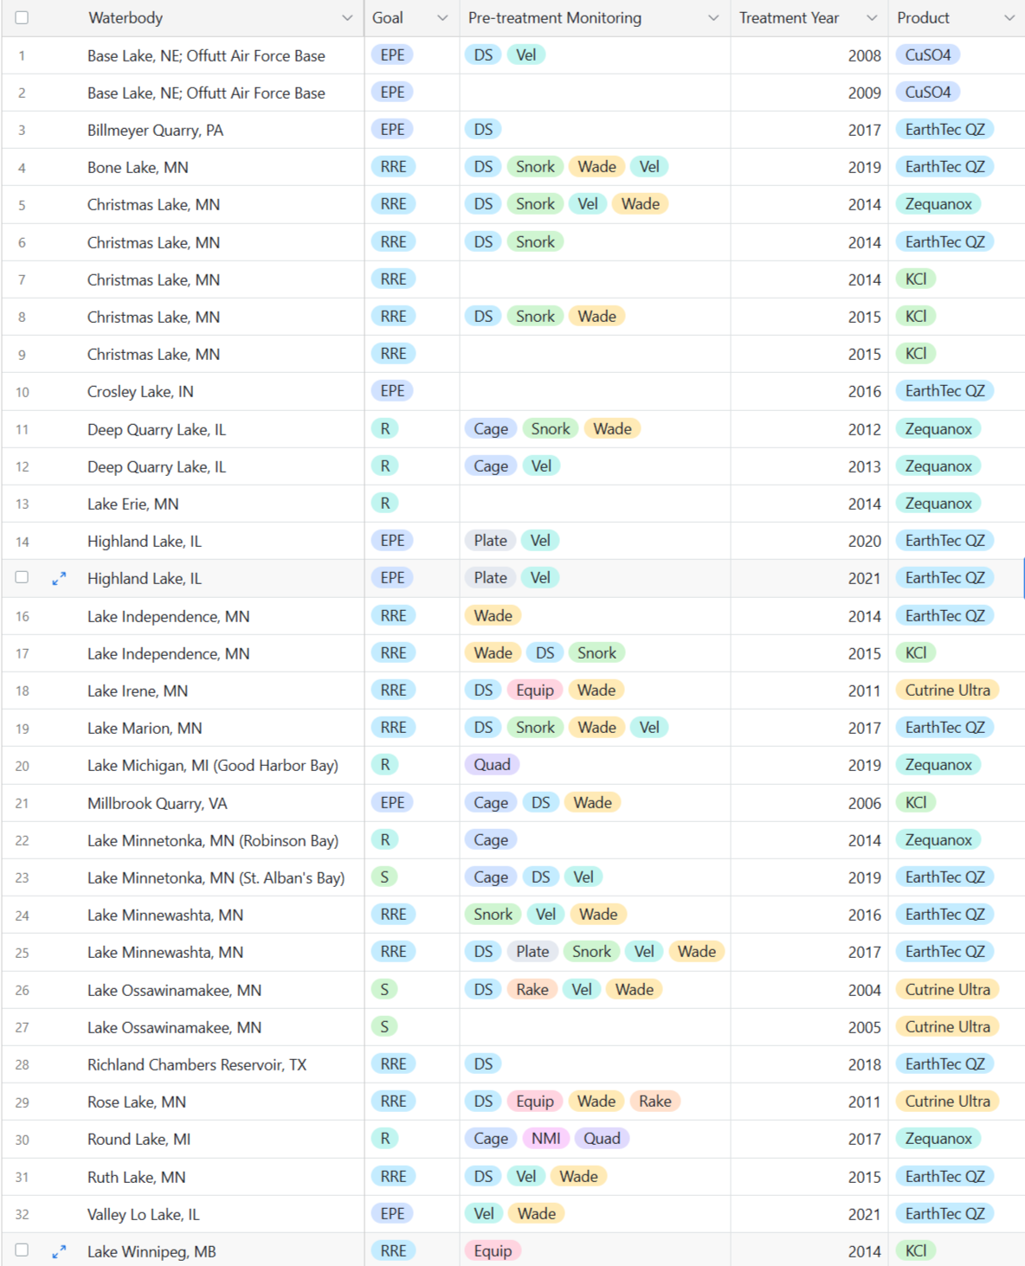
Muriate of potash section 18 emergency exemptions
Millbrook Quarry, VA (2006)
Christmas Lake, MN (2014)
Lake Winnipeg, MN (2014)
Lake Independence, MN (2015)

Slide 5
Barriers to registration
Cost
Readily available product

Slide 6
Next steps
Potential data sharing agreement with Canada
Application for use of potash as a biopesticide under Pesticide Registration Improvement Act (PRIA) code B617 (pre-application ; biochemical classification determination)coincident with a request for a fee ($4,951) waiver (PSMFC applicant)
B617 action informs the appropriate Office of Pesticide Programs (OPP) registration division
EPA’s Biopesticides and Pollution Prevention Division
EPA’s Registration Division
Stay tuned!

