Slide 1
WSU’s 2024 Dreissenid Mussel Early Detection Monitoring in the Columbia River
Steve Bollens
Gretchen Rollwagen-Bollens
Julie Zimmerman
School of the Environment
Washington State University

Slide 2
Location and number of samples collecteded in 2024 (Bi-weekly, May through October)
Sampling Location | Number of Net Samples | Number of eDNA Samples
Lake Celilo, WA | 32 | 12
Rowland Lake | 32 | 12
Bingen Harbor | 32 | 12
White Salmon | 32 | 12
White Salmon River at Underwood CUR | 32 | 12
Drano Lake | 32 | 12
Wind River | 32 | 12
Stevenson | 32 | 12
Near Bonneville Lock, Hamilton Recreation area | 32 | 12
Beacon Rock SP | 32 | 12
Washougal Marina | 32 | 12
Vancouver, near Kaiser Memorial Park | 32 | 12
Total | 384 | 144

Slide 3
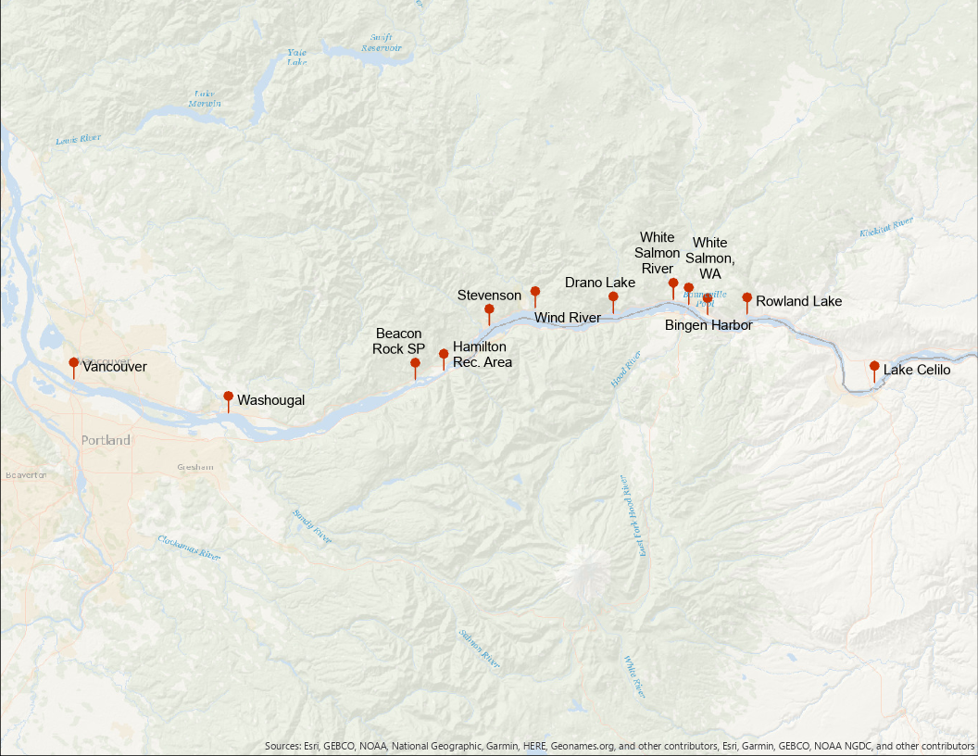
Location of samples collected in 2024

Slide 4
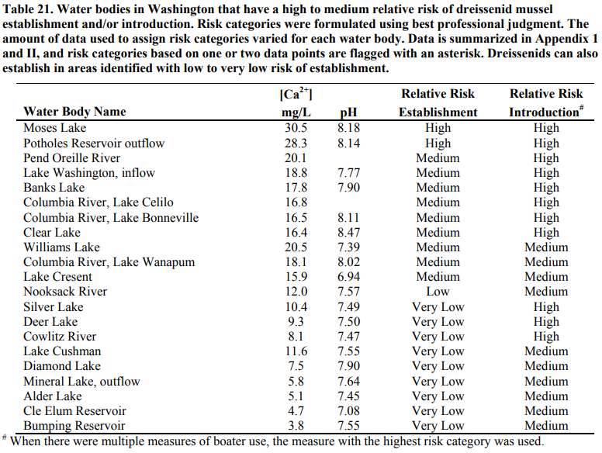
Risk assessment data used to direct sampling
Wells et al. (2011)

Slide 7
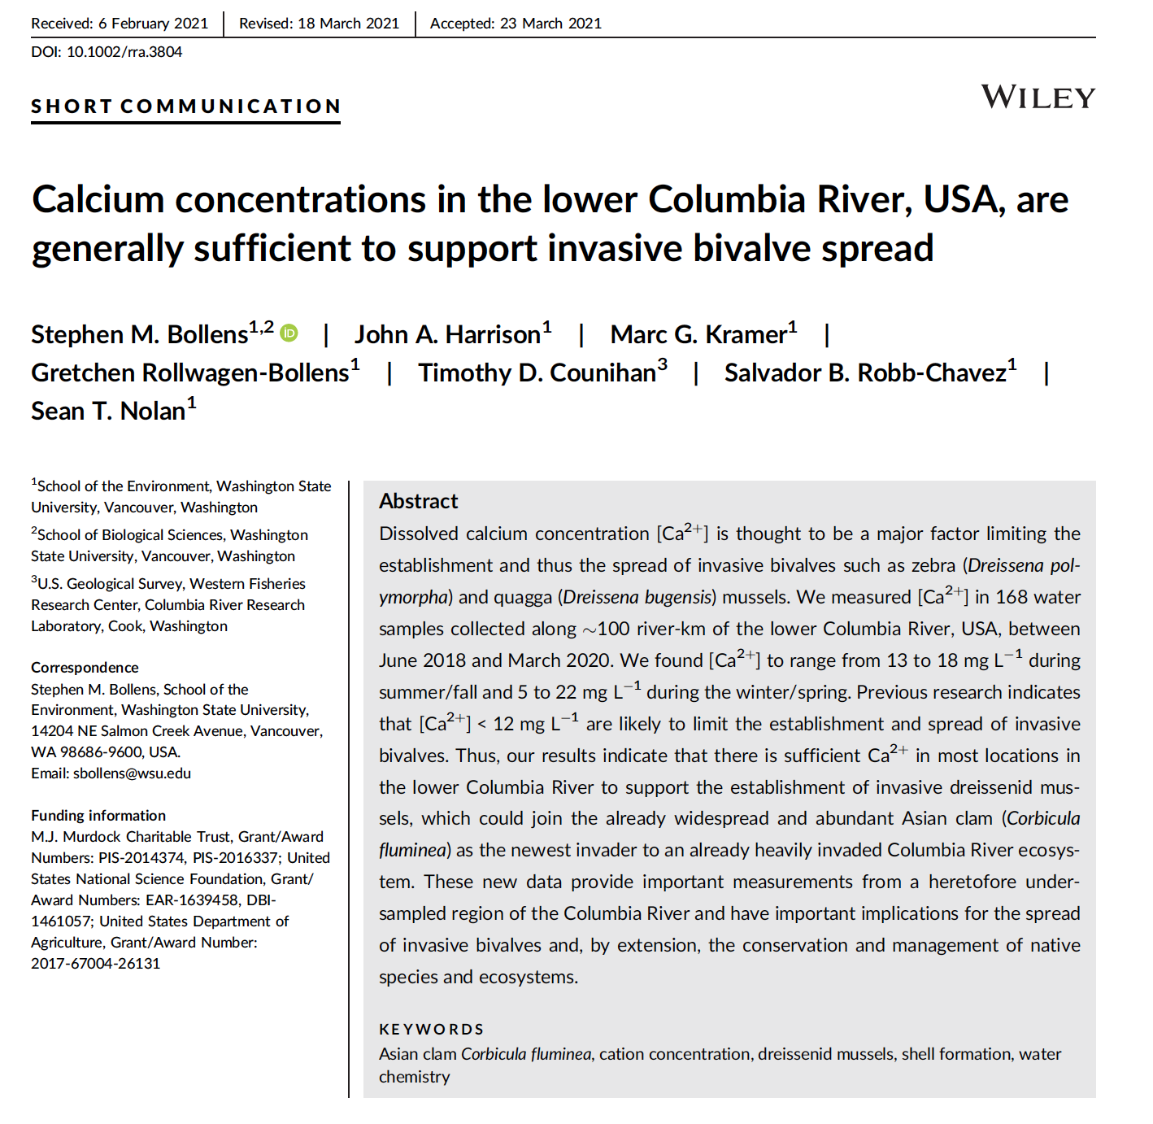

Slide 8
Given our (WSU’s) sampling locations, which range from Lake Celilo (most upstream) to Vancouver (most downstream), our risk assessment is as follows:

Slide 9
Given our (WSU’s) sampling locations, which range from Lake Celilo (most upstream) to Vancouver (most downstream), our risk assessment is as follows:
Risk of Introduction
High

Slide 10
Given our (WSU’s) sampling locations, which range from Lake Celilo (most upstream) to Vancouver (most downstream), our risk assessment is as follows:
Risk of Introduction | Risk of Establishment
High | Medium

Slide 11
Given our (WSU’s) sampling locations, which range from Lake Celilo (most upstream) to Vancouver (most downstream), our risk assessment is as follows:
Risk of Introduction | Risk of Establishment | Potential Economic Impacts
High | Medium | Extremely High

Slide 12
Given our (WSU’s) sampling locations, which range from Lake Celilo (most upstream) to Vancouver (most downstream), our risk assessment is as follows:
Risk of Introduction | Risk of Establishment | Potential Economic Impacts | Potential Ecological Impacts
High | Medium | Extremely High | Extremely High

Slide 13
Annual allocation of samples by sampling method
 |  | WATER BODY
FIELD COLLECTION METHOD | LABORATORY ANALYSIS METHOD | THE DALLES RESERVOIR | BONNEVILLE RESERVOIR | “LOWER” COLUMBIA | TOTAL
Plankton tow | CPLM Microscopy | 32 | 224 | 128 | 384
Water sample | eDNA | 12 | 84 | 48 | 144
TOTAL |  | 44 | 308 | 176 | 528

Slide 14
Final Results of 2024 Surveys: The Good News! Zero Detections of Dreissenid Veligers!
 |  | WATER BODY
FIELD COLLECTION METHOD | LABORATORY ANALYSIS METHOD | THE DALLES RESERVOIR | BONNEVILLE RESERVOIR | “LOWER” COLUMBIA | TOTAL
Plankton tow | CPLM Microscopy | 32 | 224 | 128 | 384
Water sample | eDNA | 12 | 84 | 48 | 144
TOTAL |  | 44 | 308 | 176 | 528

Slide 15
What went well and what posed difficulties?
Everything continues to go “as smooth as silk” – WSU has been doing this for many years now, so we are a “well-oiled machine.”
We see no difficulties going forward.

Slide 16
Final Food for Thought:
Can the Asian clam, Corbicula fluminea, be used as a model organism for better understanding possible invasions of other bivalves (e.g., Dreissenids) in the CRB and elsewhere?
Robb-Chavez, S, S. M. Bollens, G. Rollwagen-Bollens, and T. D. Counihan. 2023. Broadscale distribution, abundance, and habitat associations of the invasive Asian clam (Corbicula fluminea) in the lower Columbia River, USA. International Review of Hydrobiology. 1–17. https://doi.org/10.1002/iroh.202202134
Henricksen, S., and S. M. Bollens. 2022. Abundance and growth of the invasive Asian clam, Corbicula fluminea, in the lower Columbia River, USA. Aquatic Invasions. 17: 36-56. https://doi.org/10.3391/ai.2022.17.1.03
Rollwagen-Bollens, G. C., B. A. Bolam, S. M. Bollens, S. Henricksen, C. Sandison, and J. Zimmerman. 2021. Temperature-dependent functional response of the invasive Asian clam, Corbicula fluminea, feeding on natural phytoplankton. Inland Waters, 11: 250-256. https://doi.org/10.1080/20442041.2020.1843933

Slide 17
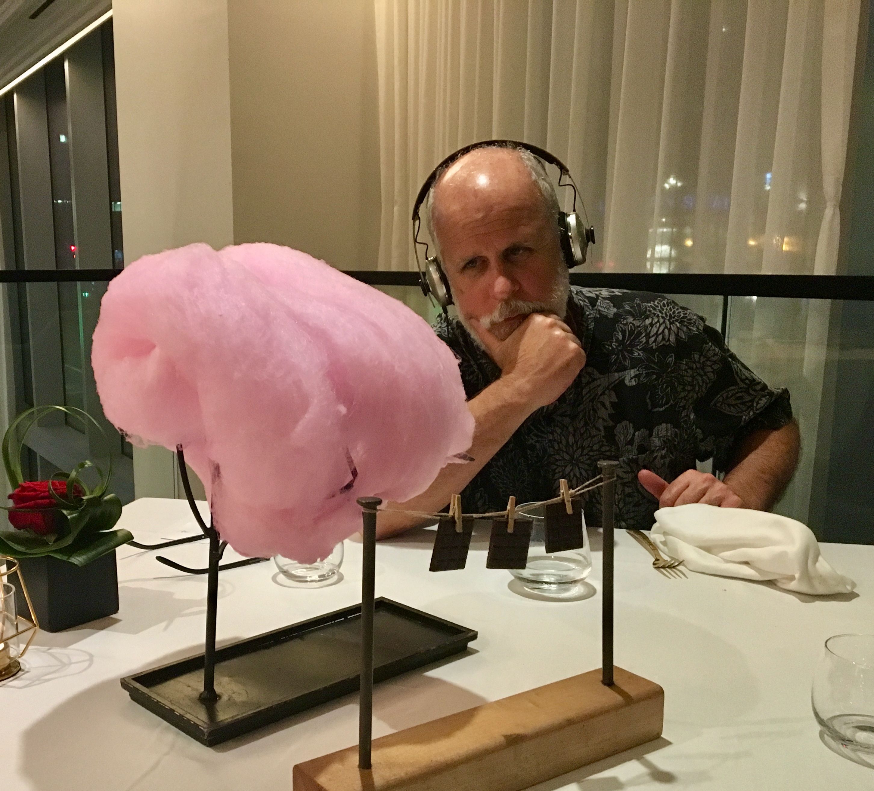

Slide 18
