Slide 1
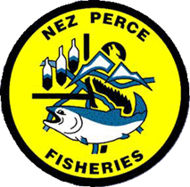
Nez Perce Tribe Department of Fisheries Resources Management: Research Division Aquatic Invasive & Nuisance Species Program
>>>
<<<
>>>
<<<
Program Lead: Clark Watry
Project Biologist: Anthony Capetillo
invasives@nezperce.org nptfisheries.org/invasives

Slide 2
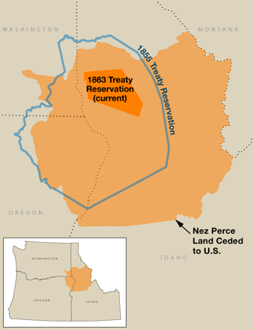
Nimiipuu Homeland
Treaty of 1855
Treaty of 1863
Indian Claims Commission (1946) – ceded territory establishes approximate area co-managed by the Nez Perce Tribe
ICC Boundary
“… fish provide us with both physical and spiritual sustenance… our fate and the fate of the fish are linked.”
- Jaime Pinkham
Area of Use and Influence

Slide 3
AINS Program Focus
Predator Control
Avian Predators
Predatory Fish
Quagga-Zebra Mussel Prevention and Early Detection Monitoring
Watercraft Inspection and Decontamination
Early Detection Monitoring in Snake and Clearwater Rivers
CD3 Wayside Stations and Check-in/Check-out signs
Other Species Reports
Serve as point of contact for Tribal members to report sightings of potential invasive species
Outreach & Education

Slide 4
NPT Predator Control Team Objectives
Objective 1: Develop/implement avian predator hazing and removal efforts
Monitor/survey avian predators for abundance and distribution upstream of LGR
Evaluate efficacy of hazing actions on in-basin stocks
Monitor redistribution of displaced predatory birds
Coordinate with State/Federal entities to permit lethal control actions if hazing ineffective/unsustainable
Objective 2: Develop and implement predatory fish removal efforts
Conduct physical removal of predatory fish with targeted gear
Monitor/survey predator abundance and distribution upstream of LGR
Evaluate efficacy of physical removal (mark-recapture or other methods)
Objective 3: Coordinate and collaborate with Snake and Columbia Basin co-managers
Secure/maintain necessary permits
Regional collaboration/coordination
Sponsor non-native predator tournaments/derbies (citizen-based science approach)
Collaborate on outreach and public relations campaigns

Slide 5
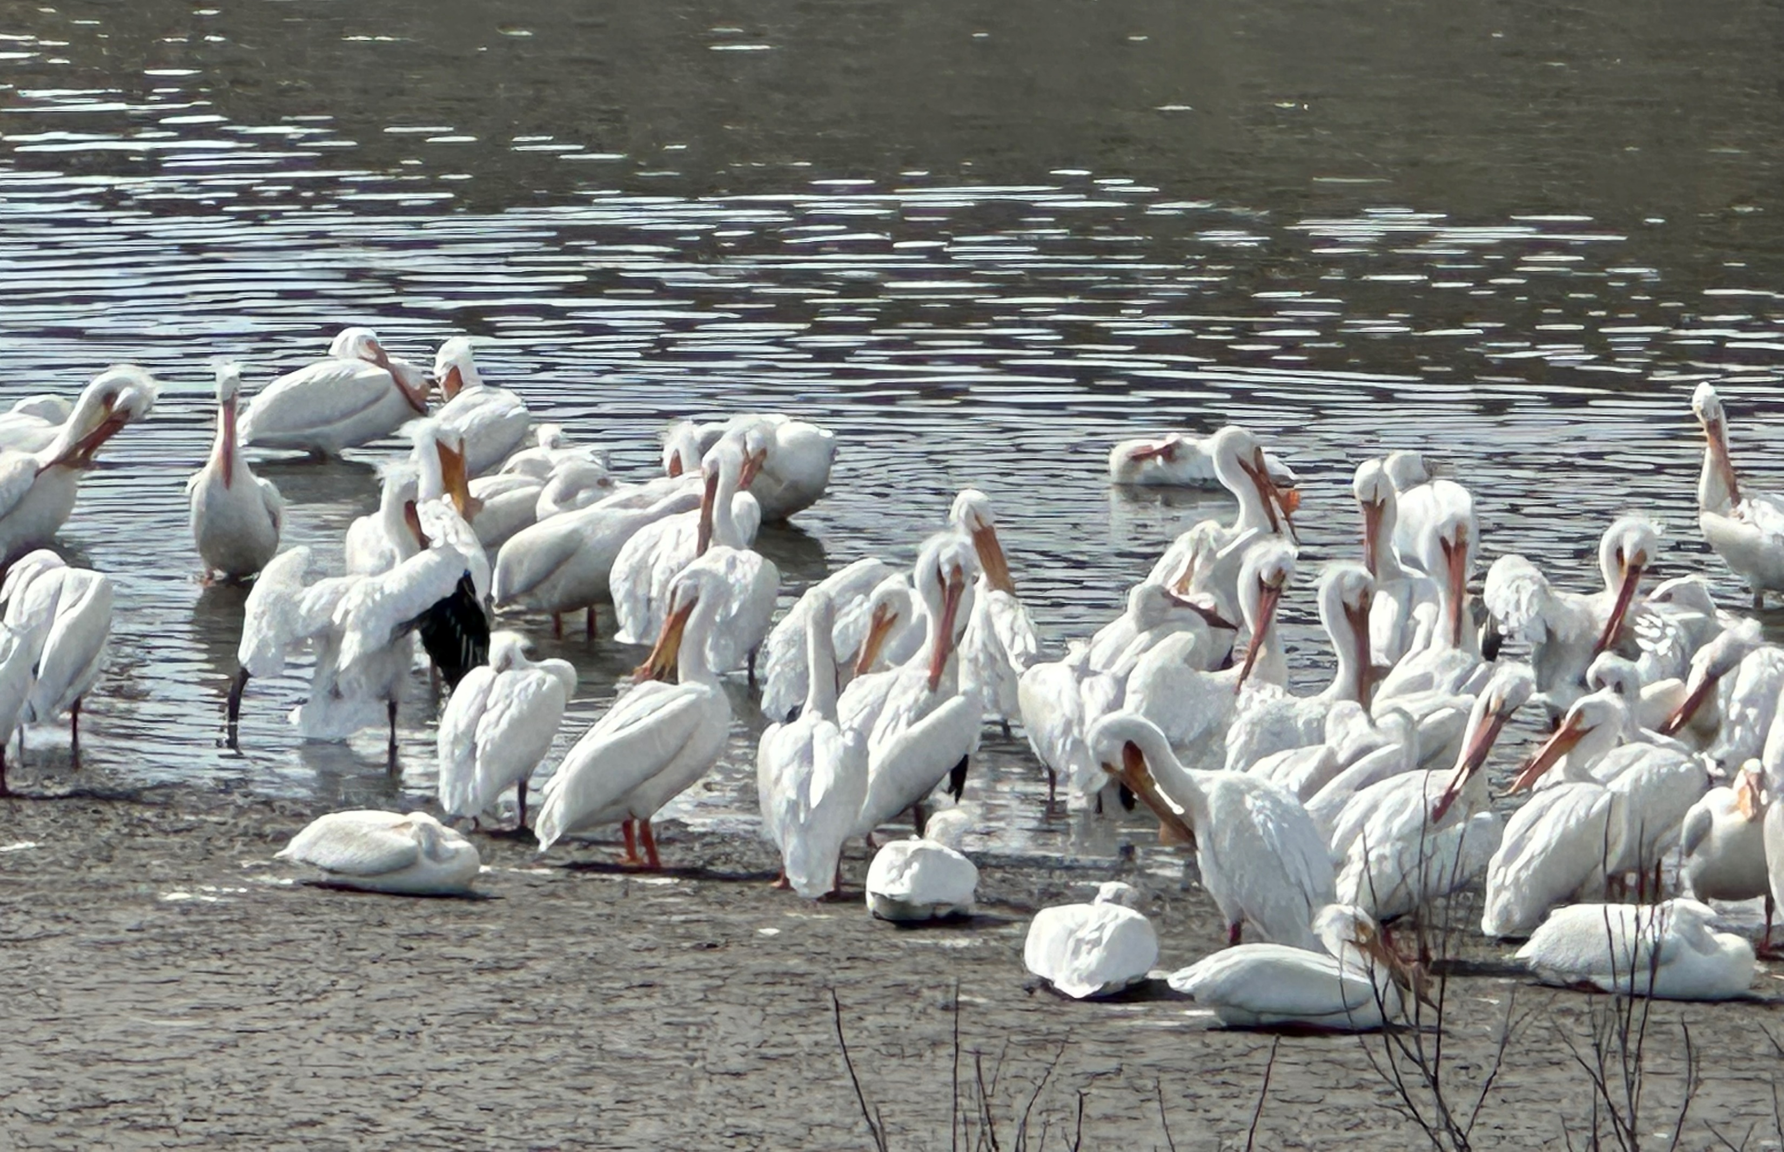
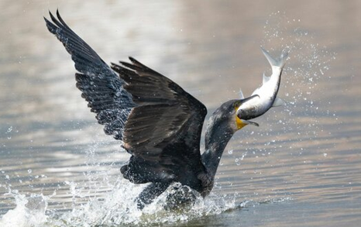
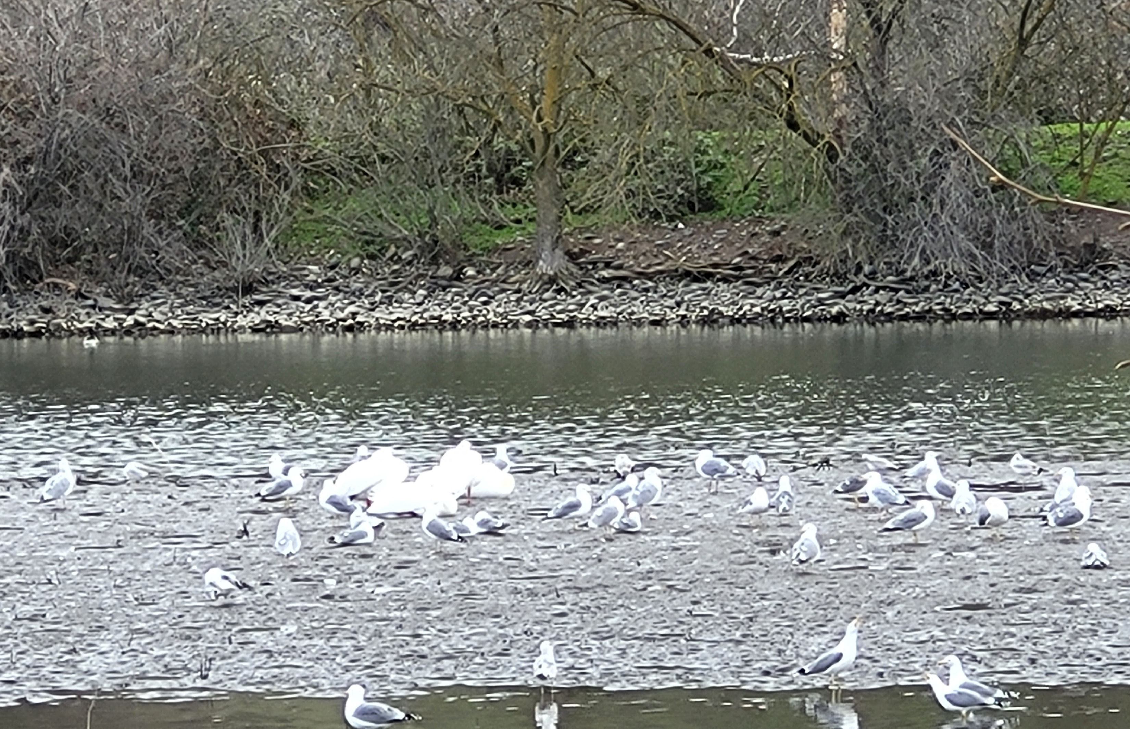
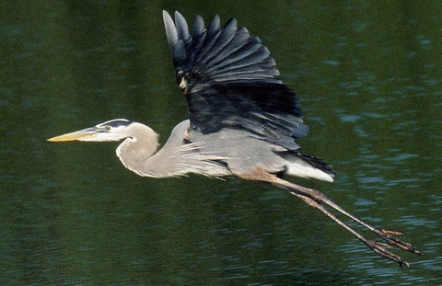
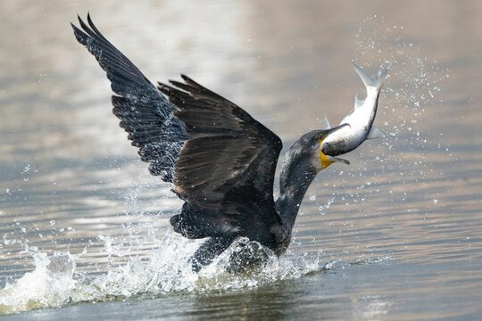
Avian Predators of Concern
Photo credit: National Audobon Society
Photo credit: USFWS

Slide 6
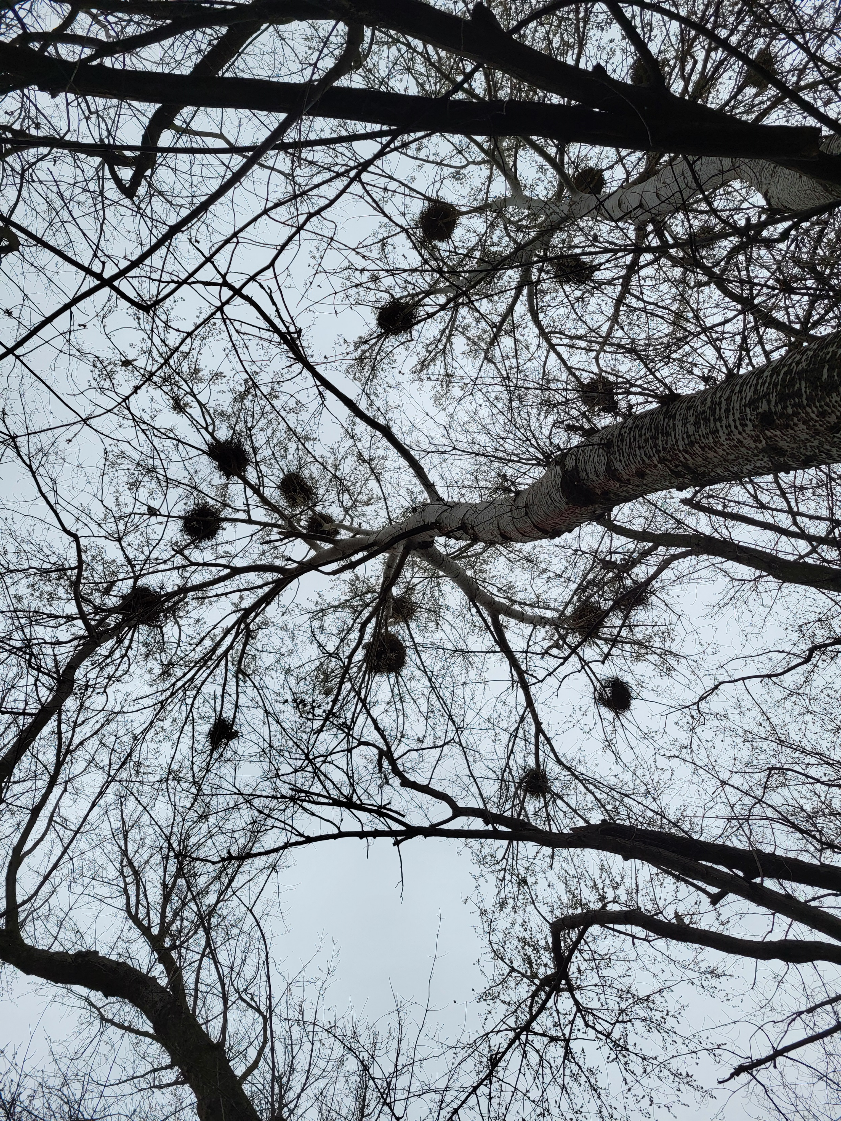
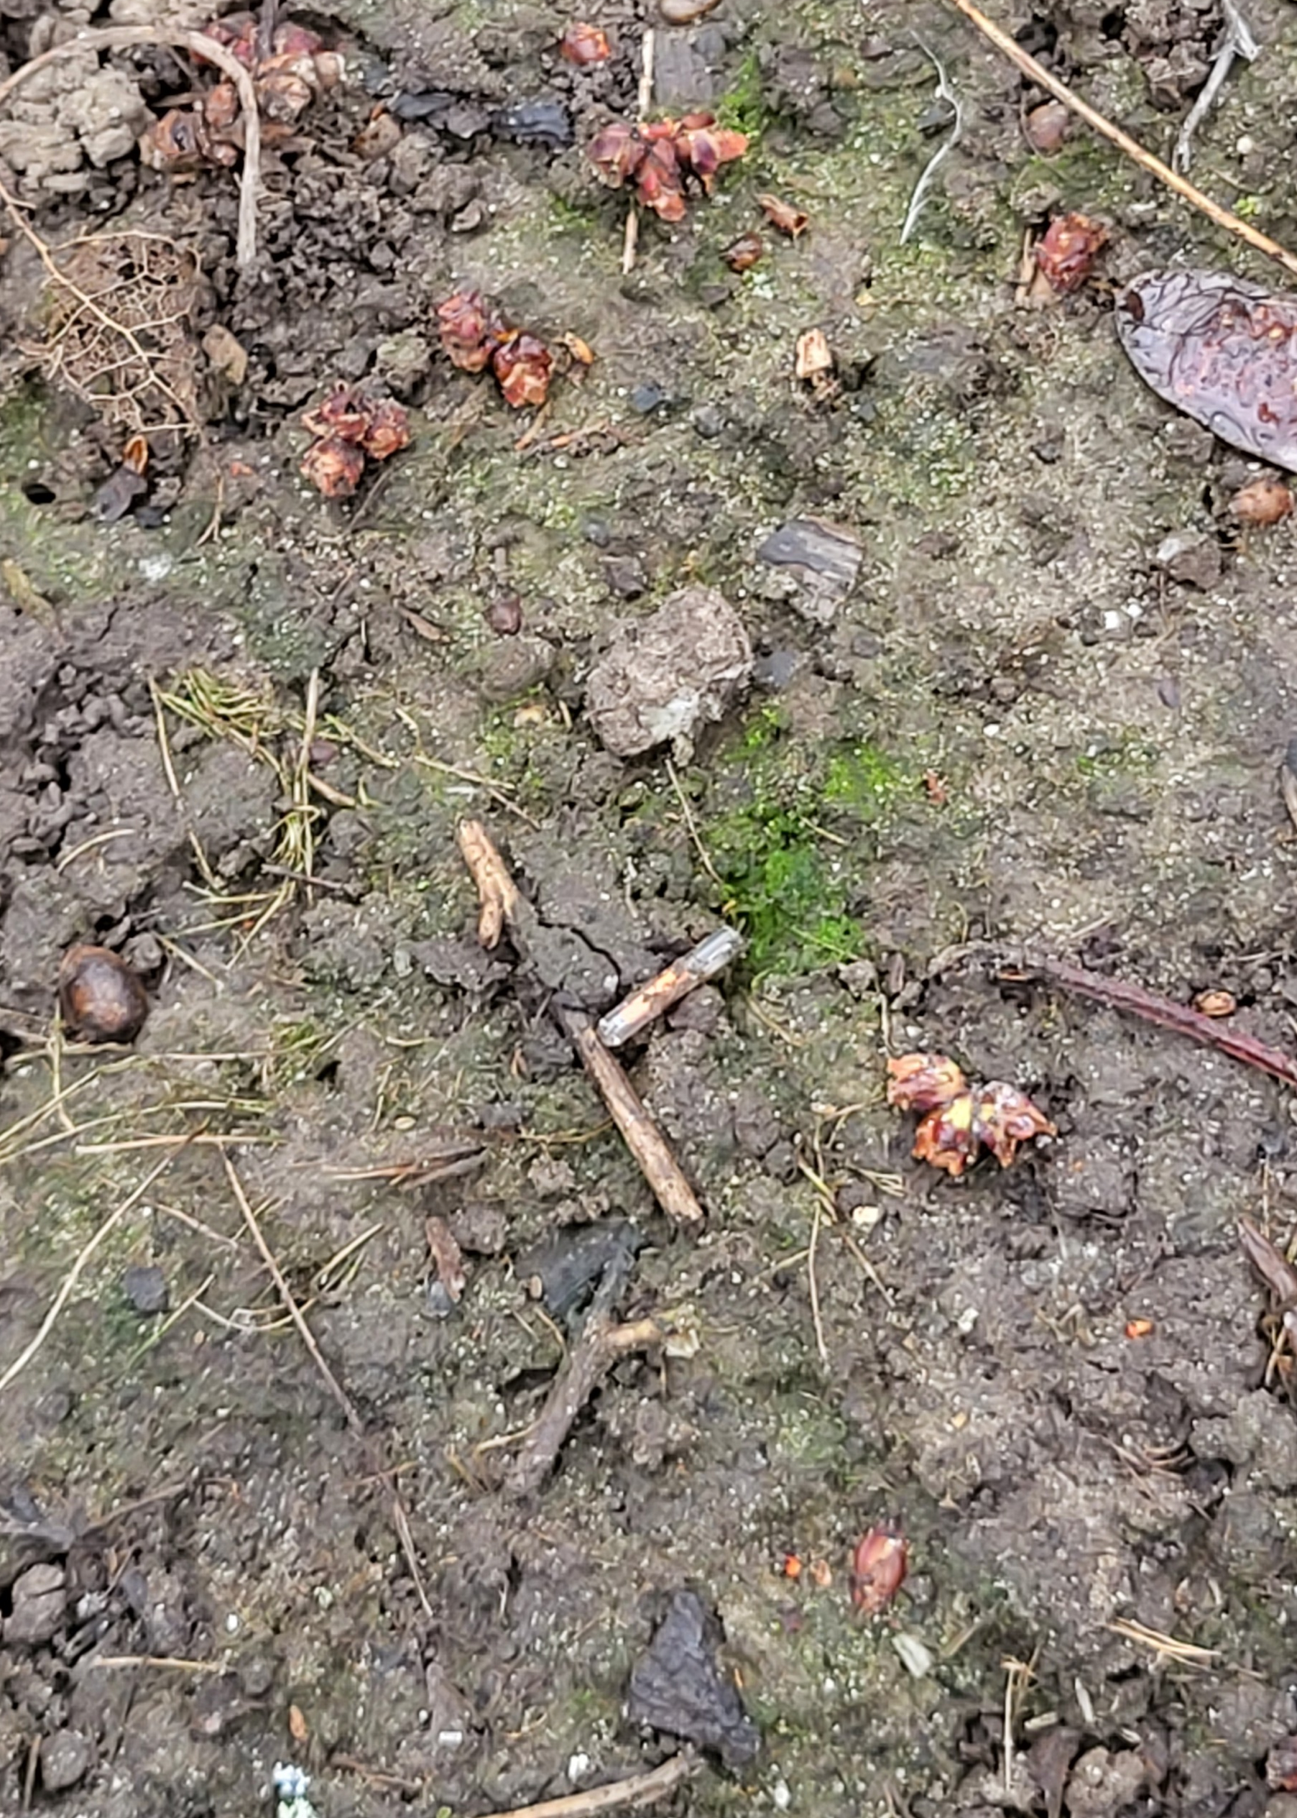
Potential Impacts to Juvenile Salmonids
1,471 unique PIT tags under one of the heron rookeries at Spalding Park
Release years 2014-2024
874 Chinook salmon
419 steelhead
165 coho salmon
10 sockeye salmon
1 lamprey
1 pikeminnow
296 unique PIT tags on bar/island on Clearwater River
Release years 2018-2023
Primarily occupied by gulls and pelicans
111 Chinook salmon
167 steelhead
18 coho salmon

Slide 8
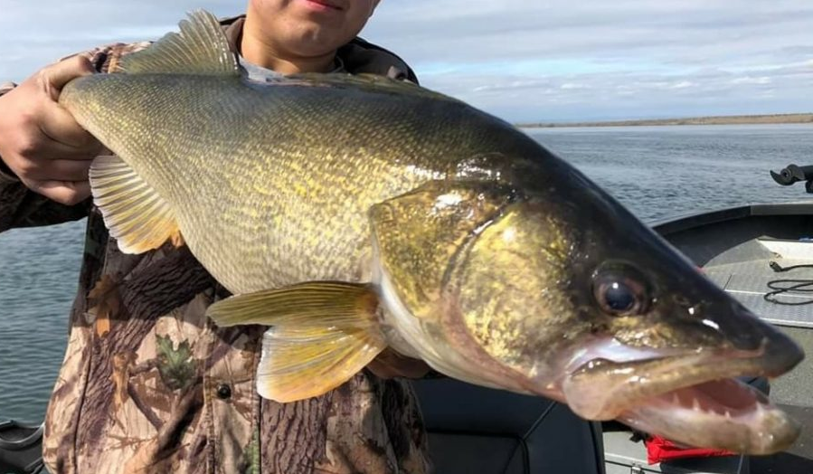
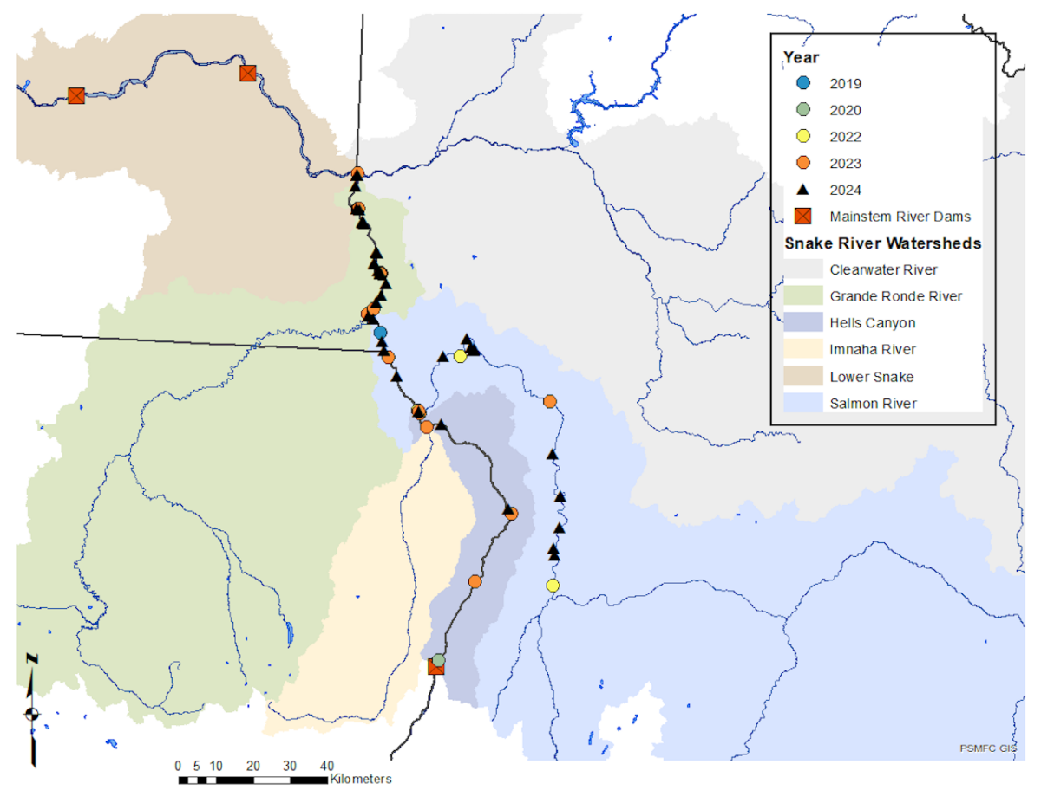
Predatory Fish of Concern
Walleye Invasion into Snake and Salmon rivers
(IDFG, 2019 – 2024).
Photo credit: Northwest Sportsman Magazine
Photo credit: IDFG

Slide 9
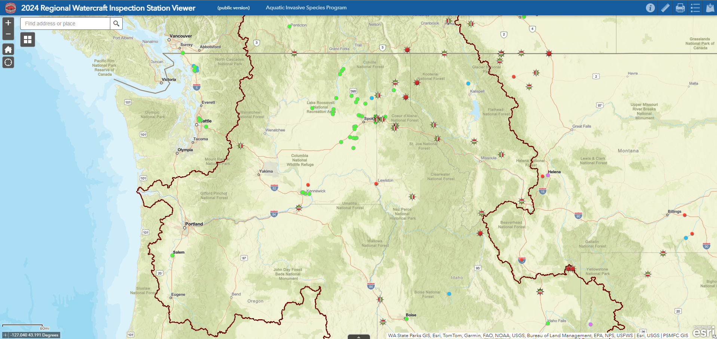
QZM Prevention & Early Detection
Kooskia

Slide 10
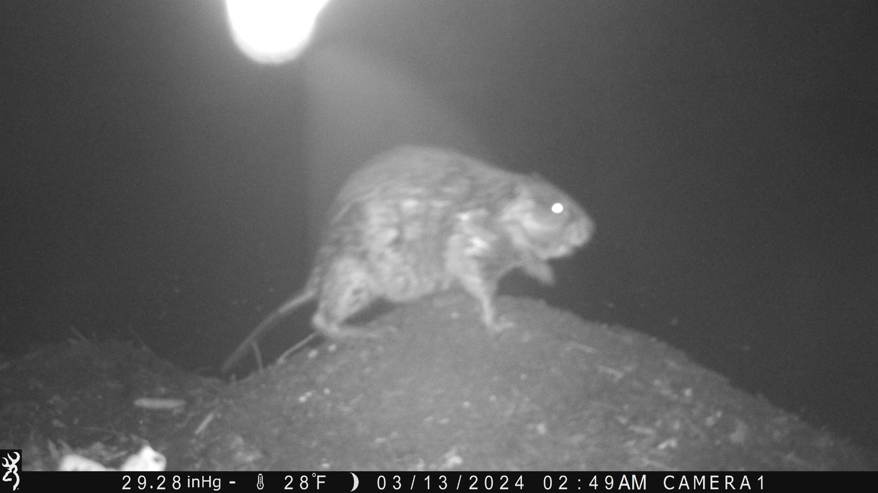
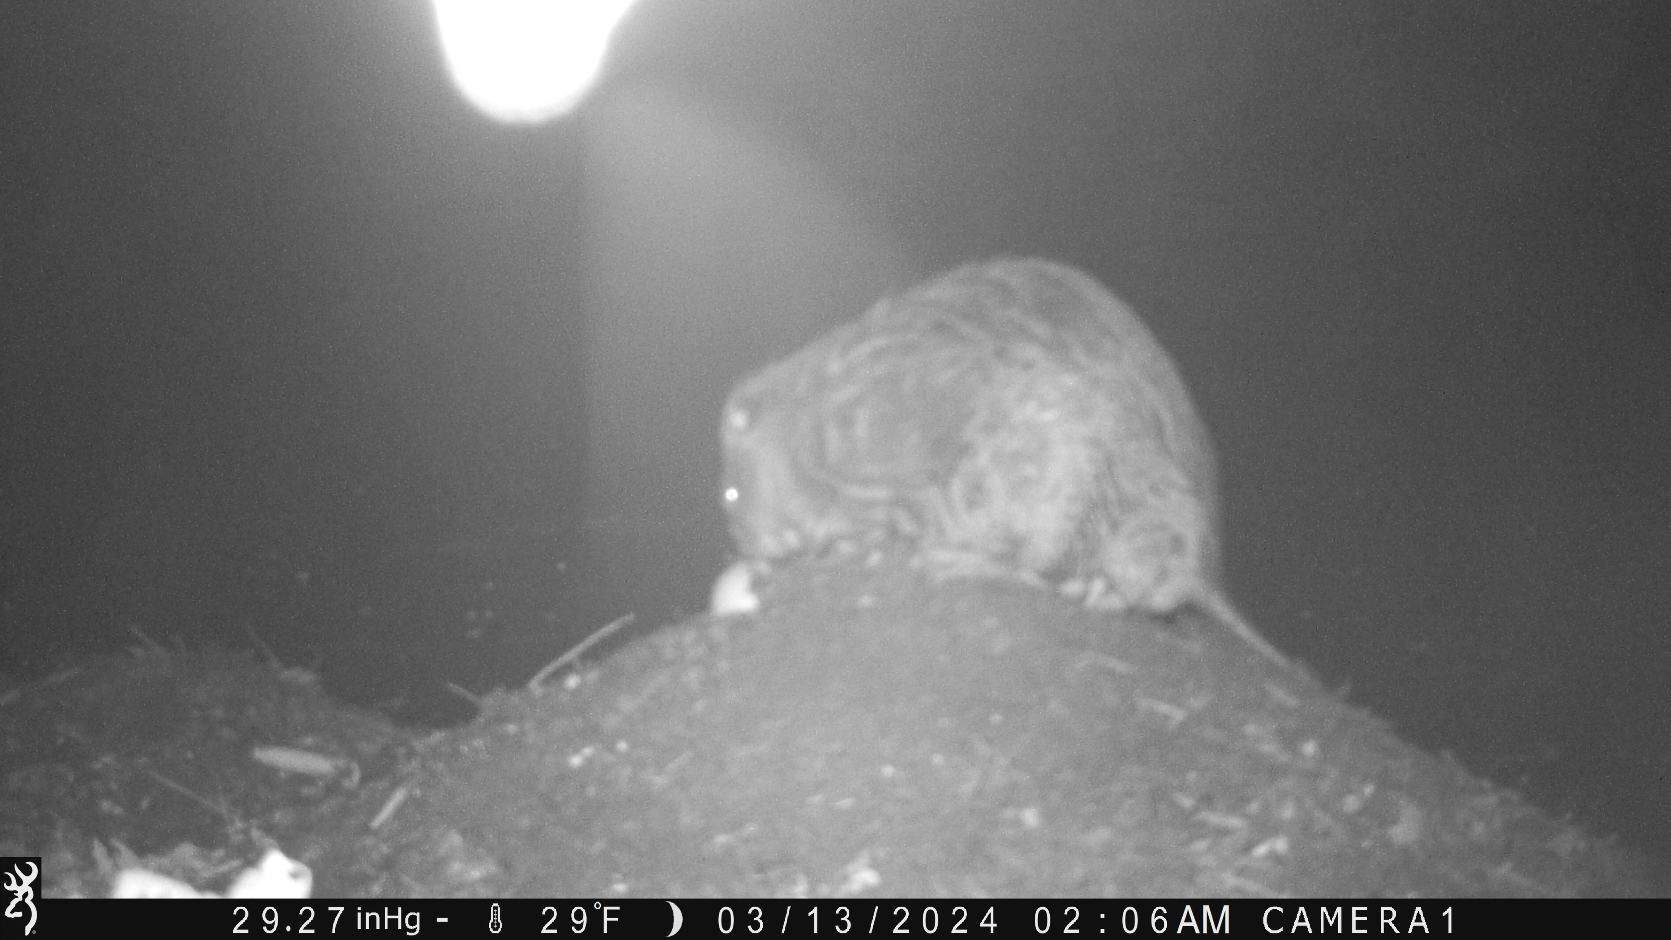
Other Species Sightings

Slide 11
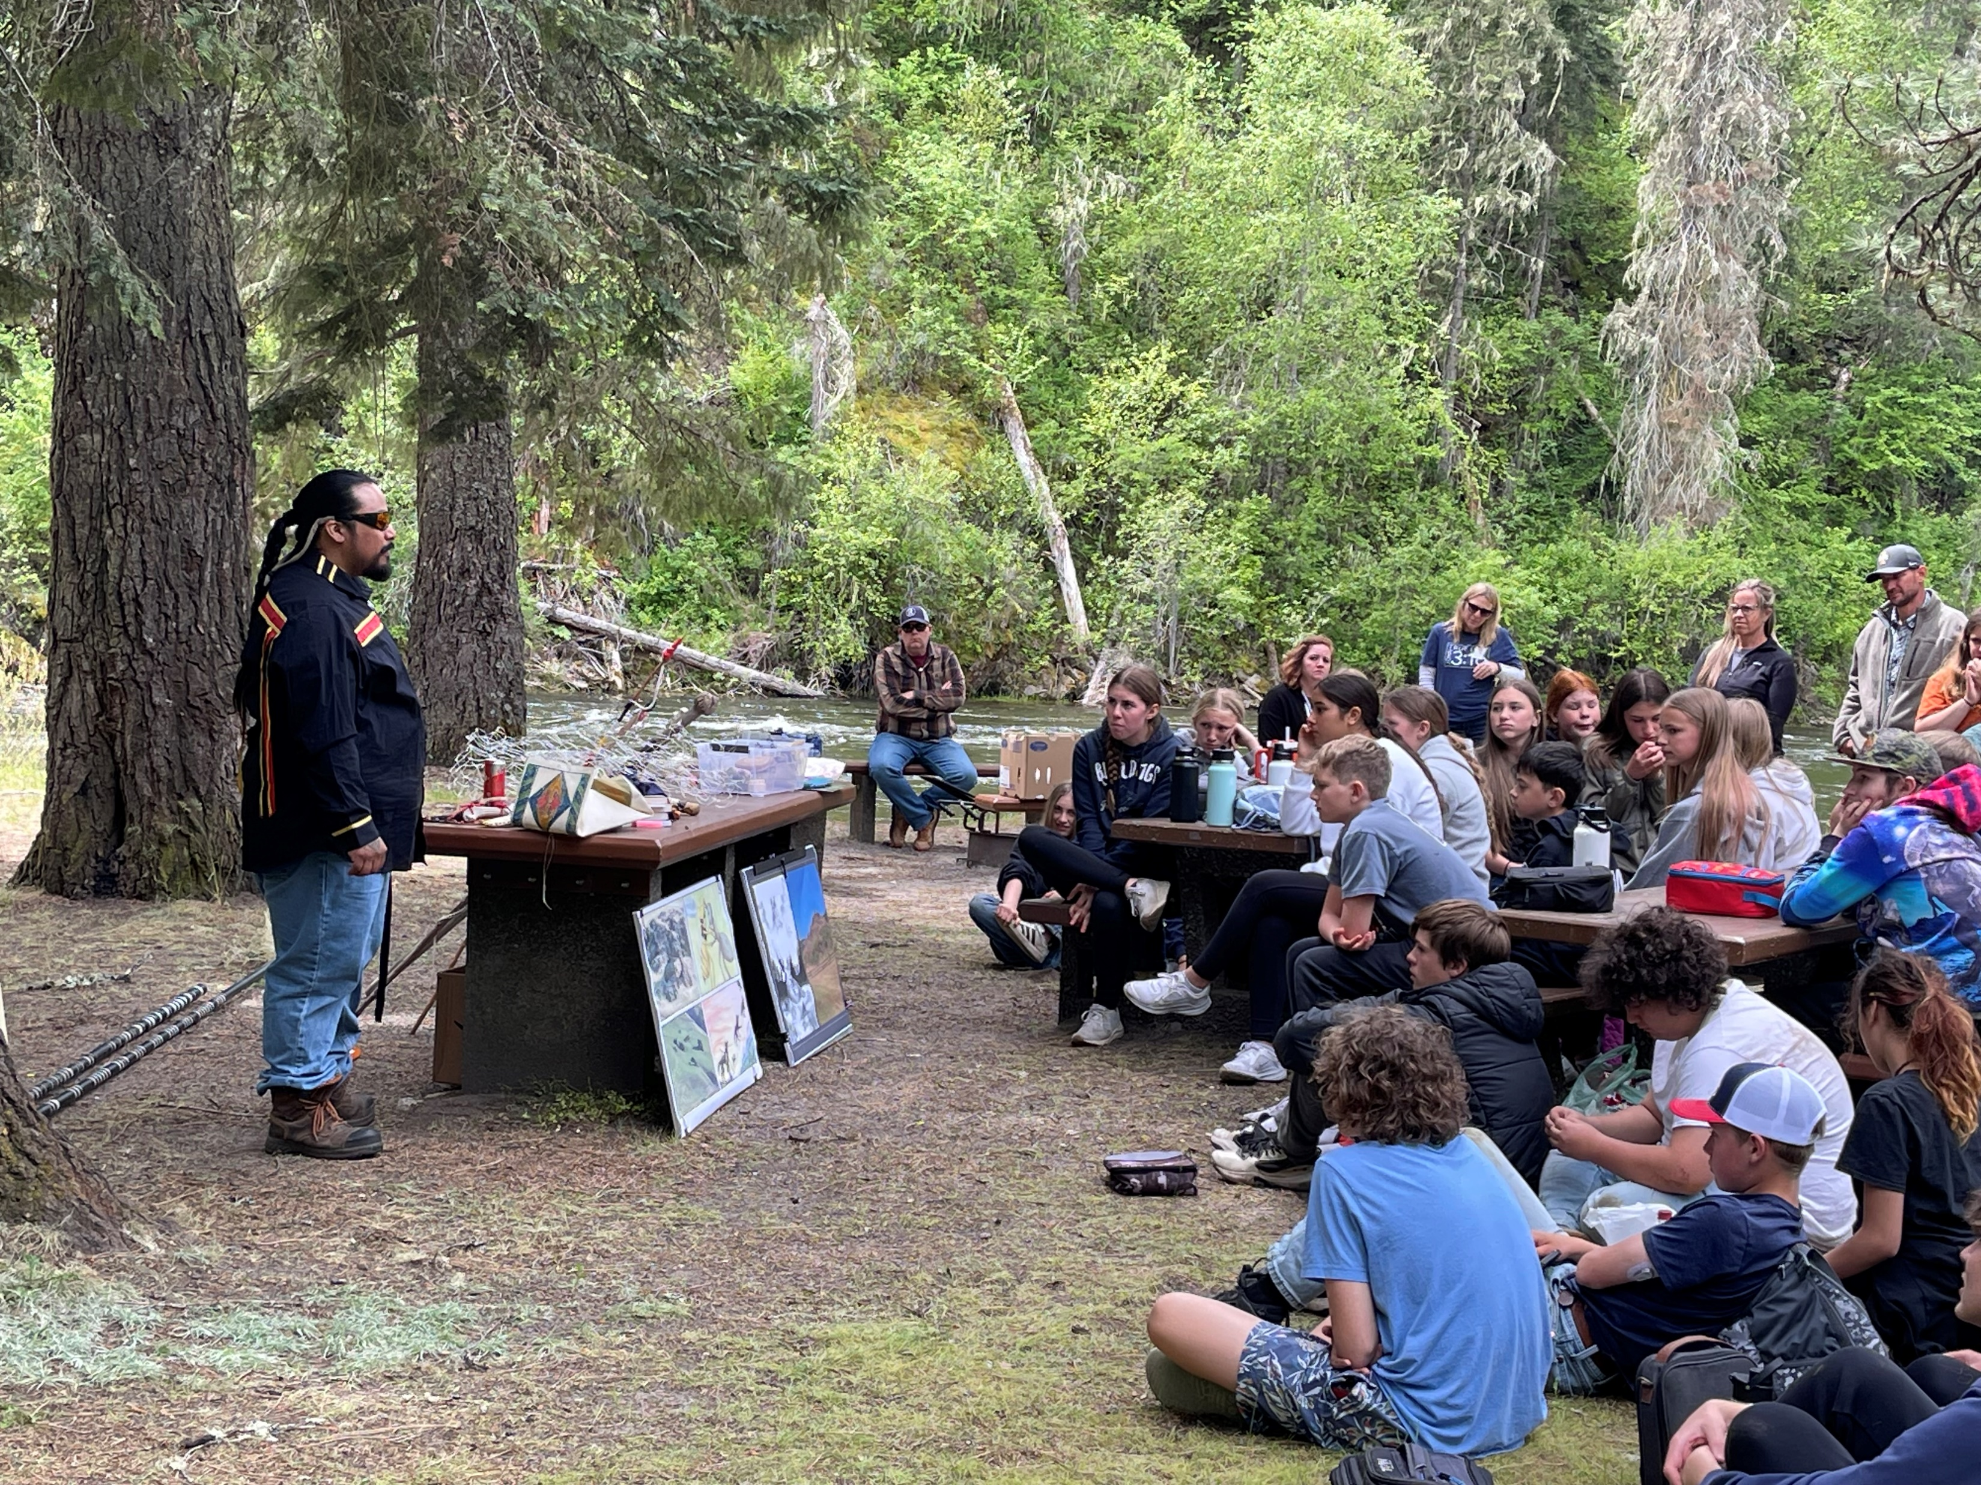
Outreach and Education
PSA’s on Tribal Radio Station (KIYE)
STEM Fairs
Career Fairs
Local Classrooms
Festivals and other events
Tribal Knowledge Forums
National Invasive Species Awareness Week (Feb 24 – 28)
nptfisheries.org/invasives
Demonstrations
Other Events locally (as planned)

Slide 12
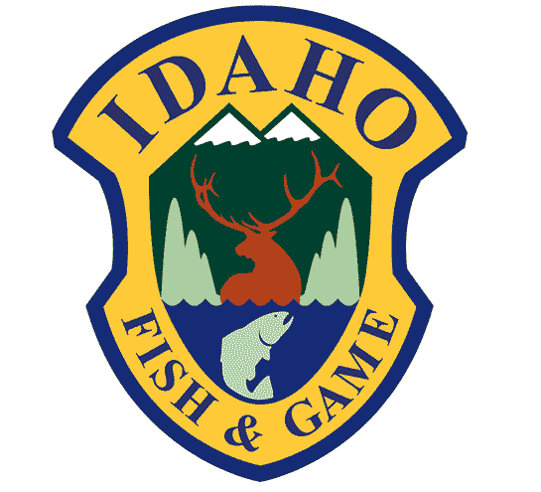
Partners

