Slide 1
2024 ISDA Update
Cole D Morrison

Slide 2
Summary
2 New Stations
Increased operating window
Increased hours
Increase in inspections
Increase in compliance
Notes:
Watercraft inspections
2 new stations active in 2024 (Boundary and Centennial). Total of 22 in the state in 2024.
At least 2 additional planned for 2025 (Shoshone Falls and Twin Falls)
Additional talks for a station on Bear Lake.
50% of inspection stations increased their season by a month or longer (Bruneau, Marsing, Cotterell, Malad, Franklin, Albeni Falls, Samuels, Clark Fork, HWY 93).
Stations were able to extend daily operation hours (Island Park open 16 hours instead of 12)
Inspections increased:
113,733 in 2021, 102,688 in 2022, 104,169 in 2023, 156,326 in 2024.
Decontaminations increased:
665 in 2022, 1229 in 2023, 8580 in 2024.
Compliance rate for decons increased (boats needing washed vs those that consented to the wash).
~40% in 2023 to ~70% in 2024.
Standardized decontaminations (engine/ballast flush)

Slide 8
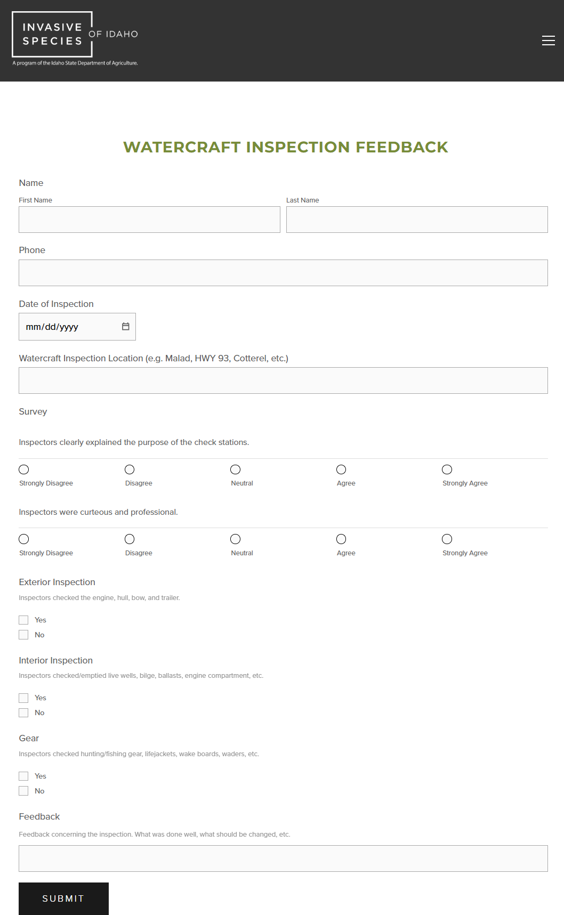
Moving Forward
QA/QC efforts
Deploy mandatory decons for out of state watercraft
eDNA
Advanced decon training?

Slide 9
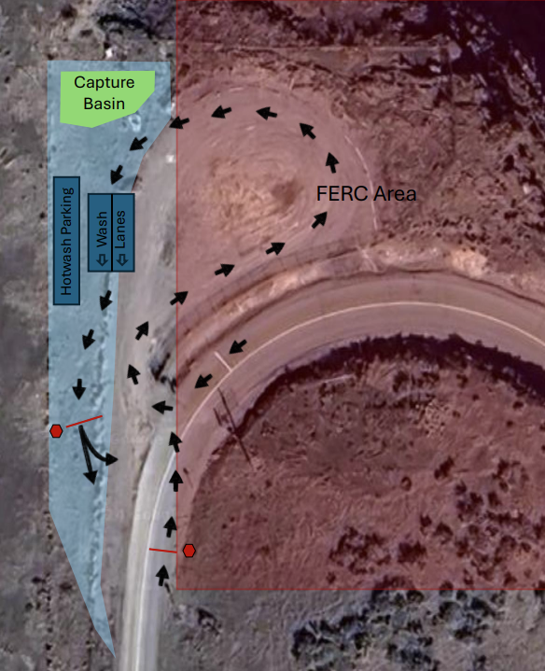
New Stations
Shoshone Falls and Twin Falls
Open 2025

Slide 10
Questions?
Cole D Morrison
208-316-0578
Cole.Morrison@isda.idaho.gov

